Slide 1
Digital Frameworks
Lesson 1
Medill on the Hill
Sean McMinn
https://github.com/shmcminn/digitalframeworks-summer18

Slide 2
Intros
Hi there! I’m Sean McMinn. When I’m not standing up here, I’m busy being a data reporter at CQ and Roll Call, where I make graphics and write stories based on *~data~*

Slide 3
Digital Frameworks?
Yep, it’s vague
Notes:
We’re going to focus primarily on using data to tell a story. We’ll also work a bit on digital presentation, mostly of data stories.

Slide 4
Why do YOU need data?
The worst advice I ever got:
Don’t take an intro statistics class. Either trust your intuition or hire a statistician.
Notes:
Anecdote: When I was in high school, I was thinking about taking a statistics class. My dad, who was a business consultant, said I should spend my time learning something else. He suggested that if I needed stats, I should either trust my intuition or hire a statistician.

Slide 5
Why do YOU need data? (cont.)
The worst advice I ever got:
Don’t take an intro statistics class. Either trust your intuition or hire a statistician.
Your intuition is not as good as you think
How do you ask a good question? What if your statistician is lying?
Maybe you’ll discover that you want to BE the statistician
Notes:
This isn’t statistics, but caution applies. You need to be able to get started yourself and know when you’re in over your head with data/digital stuff. You need to be able to ask good questions and gauge the responses you get to decide whether to trust them. And maybe you’ll like this stuff so much that you decide it’s what you actually want to be doing. It happens a lot. It happened to me.

Slide 6
When we think about data...
Notes:
When you think about data and data journalism, what kinds of stories do you think about?

Slide 7
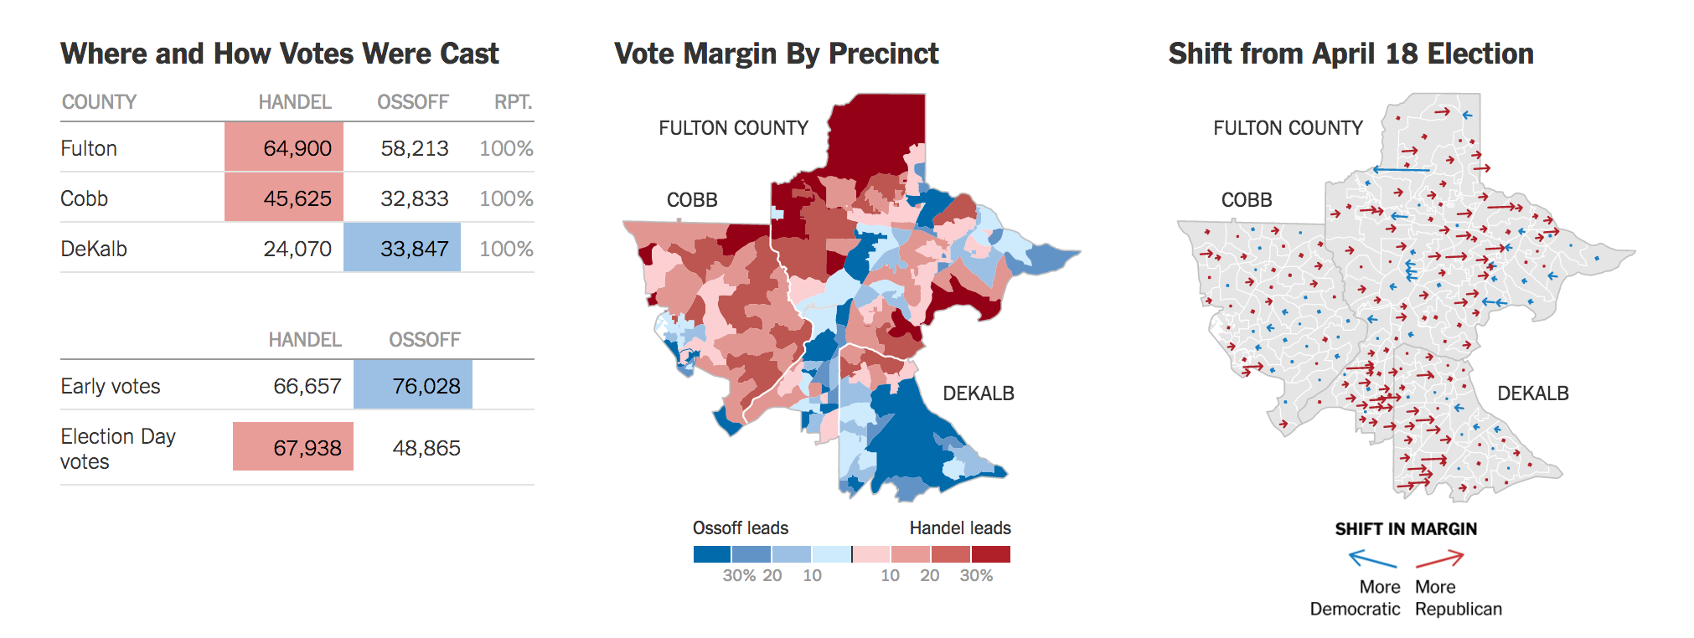

Slide 8
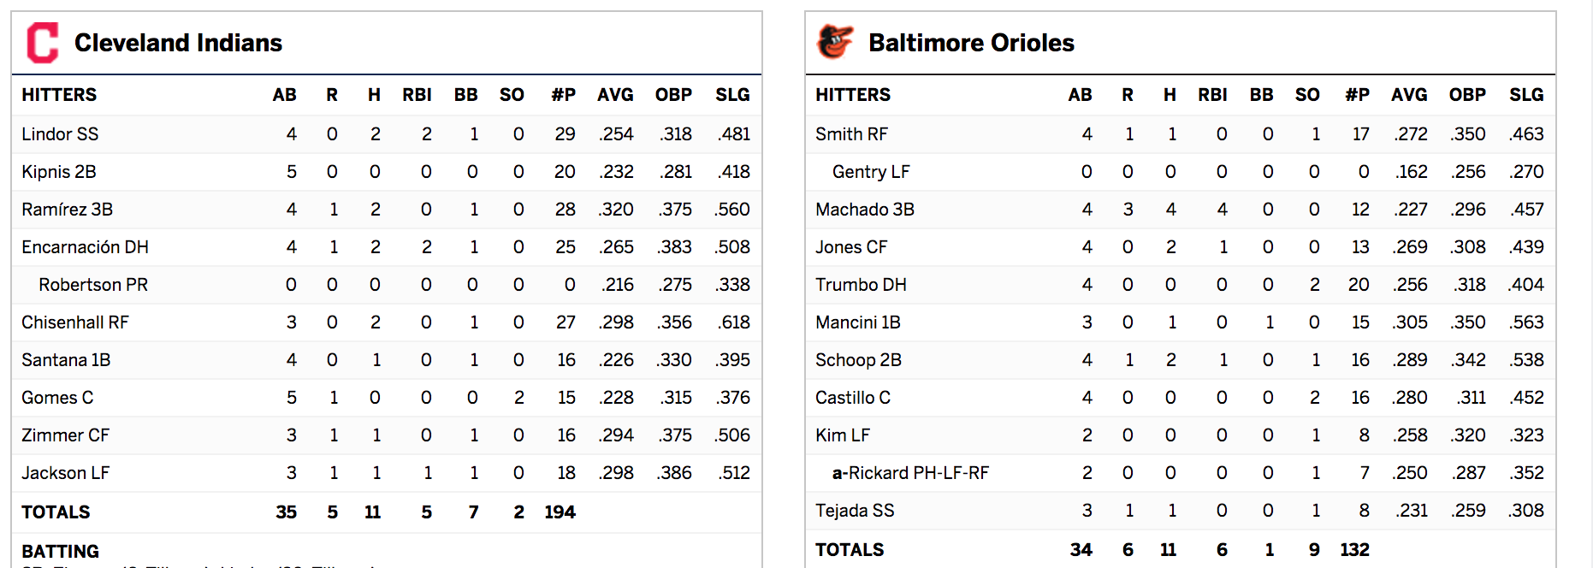

Slide 9
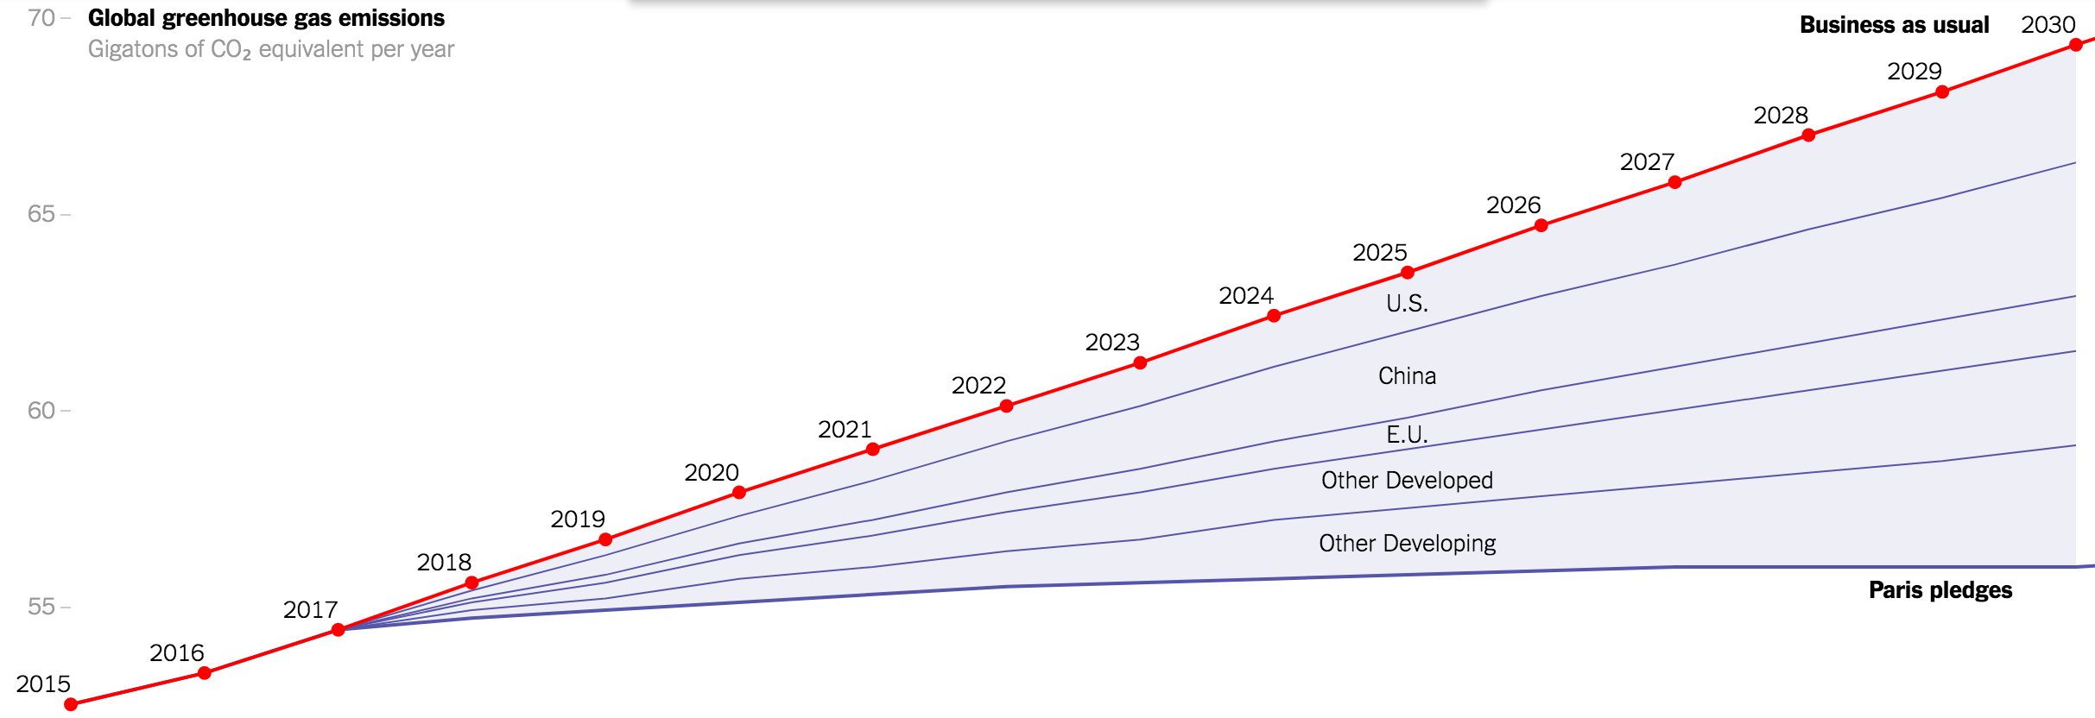

Slide 10
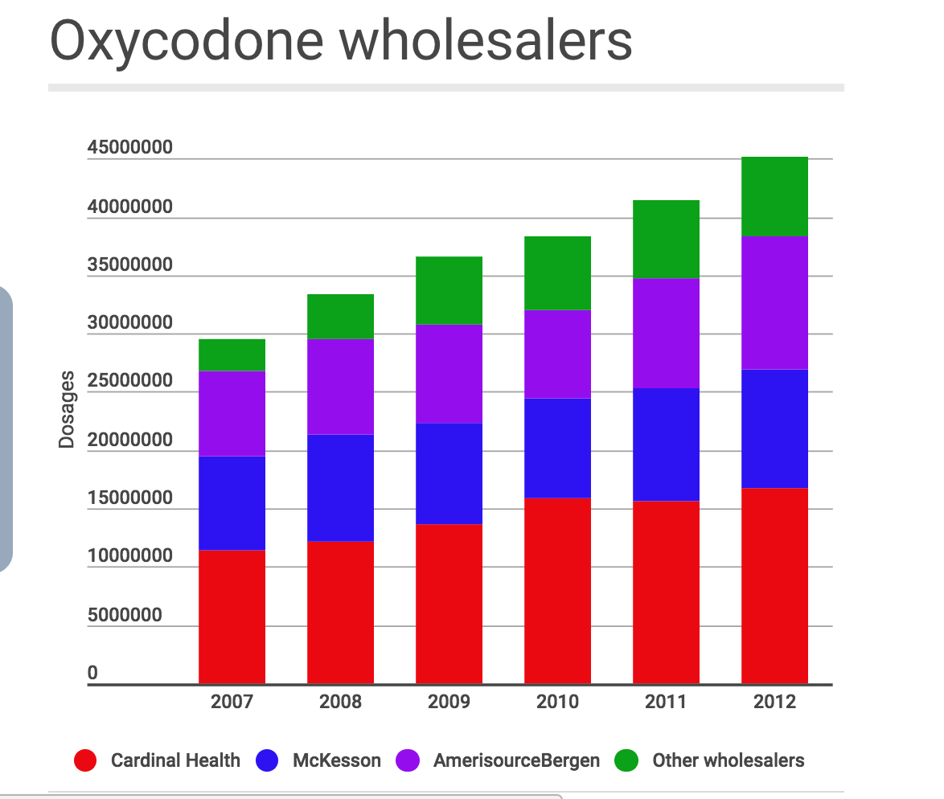
The trail of painkillers leads to West Virginia's southern coalfields, to places like Kermit, population 392. There, out-of-state drug companies shipped nearly 9 million highly addictive — and potentially lethal — hydrocodone pills over two years to a single pharmacy in the Mingo County town.
Notes:
While this chart might not win a pulitzer, the story did (it was just hard to get a good screenshot of the hed given where the ads were).

Slide 11
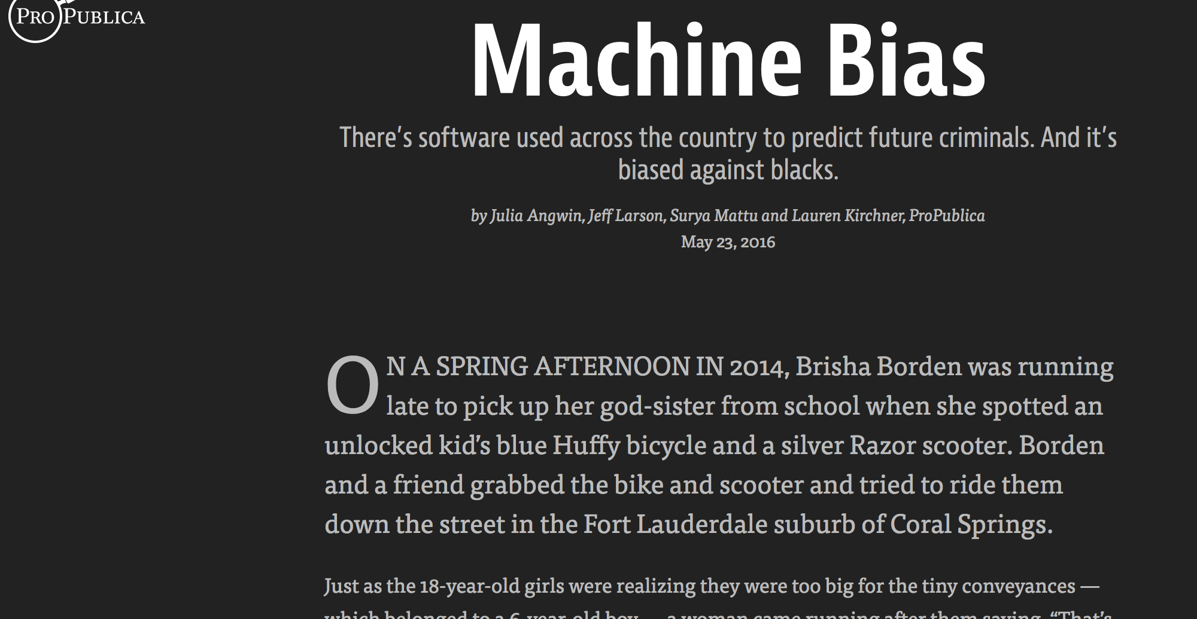

Slide 12
...but many non-data stories are actually data stories
The following few slides are from a talk I gave at the Library of Congress titled “Structured Data Storytime” about some less obvious uses of data and technology in NYT journalism
Notes:
(these examples are going to be times-heavy bc it’s sometimes hard to know the backstory of a data-assisted story unless you were there)

Slide 13

Notes:
I’m a member of the interactive news team at the New York Times. We work on a variety of projects, but we often end up being pulled in when reporters get stuck trying to get a full understanding of a data collection. We pitch in when the data is hard to get. We pitch in when the format is unusable. We pitch in when there’s just too much data. And we pitch in when it feels like there should be a data set but it’s just not clear where. When you read the resulting stories, sometimes it’s clear how data contributed. Sometimes you’d have no idea. So I’m here today to tell the data stories behind the stories. This is what happens when you put programmers in your newsroom and give them a little flexibility.

Slide 14
Once upon a time...
...a reporter was
on a tight deadline
(!)
Notes:
Shocker, I know. So this reporter had a list of House members, and they wanted to see how each of their fundraising was going compared to their opponents.

Slide 15
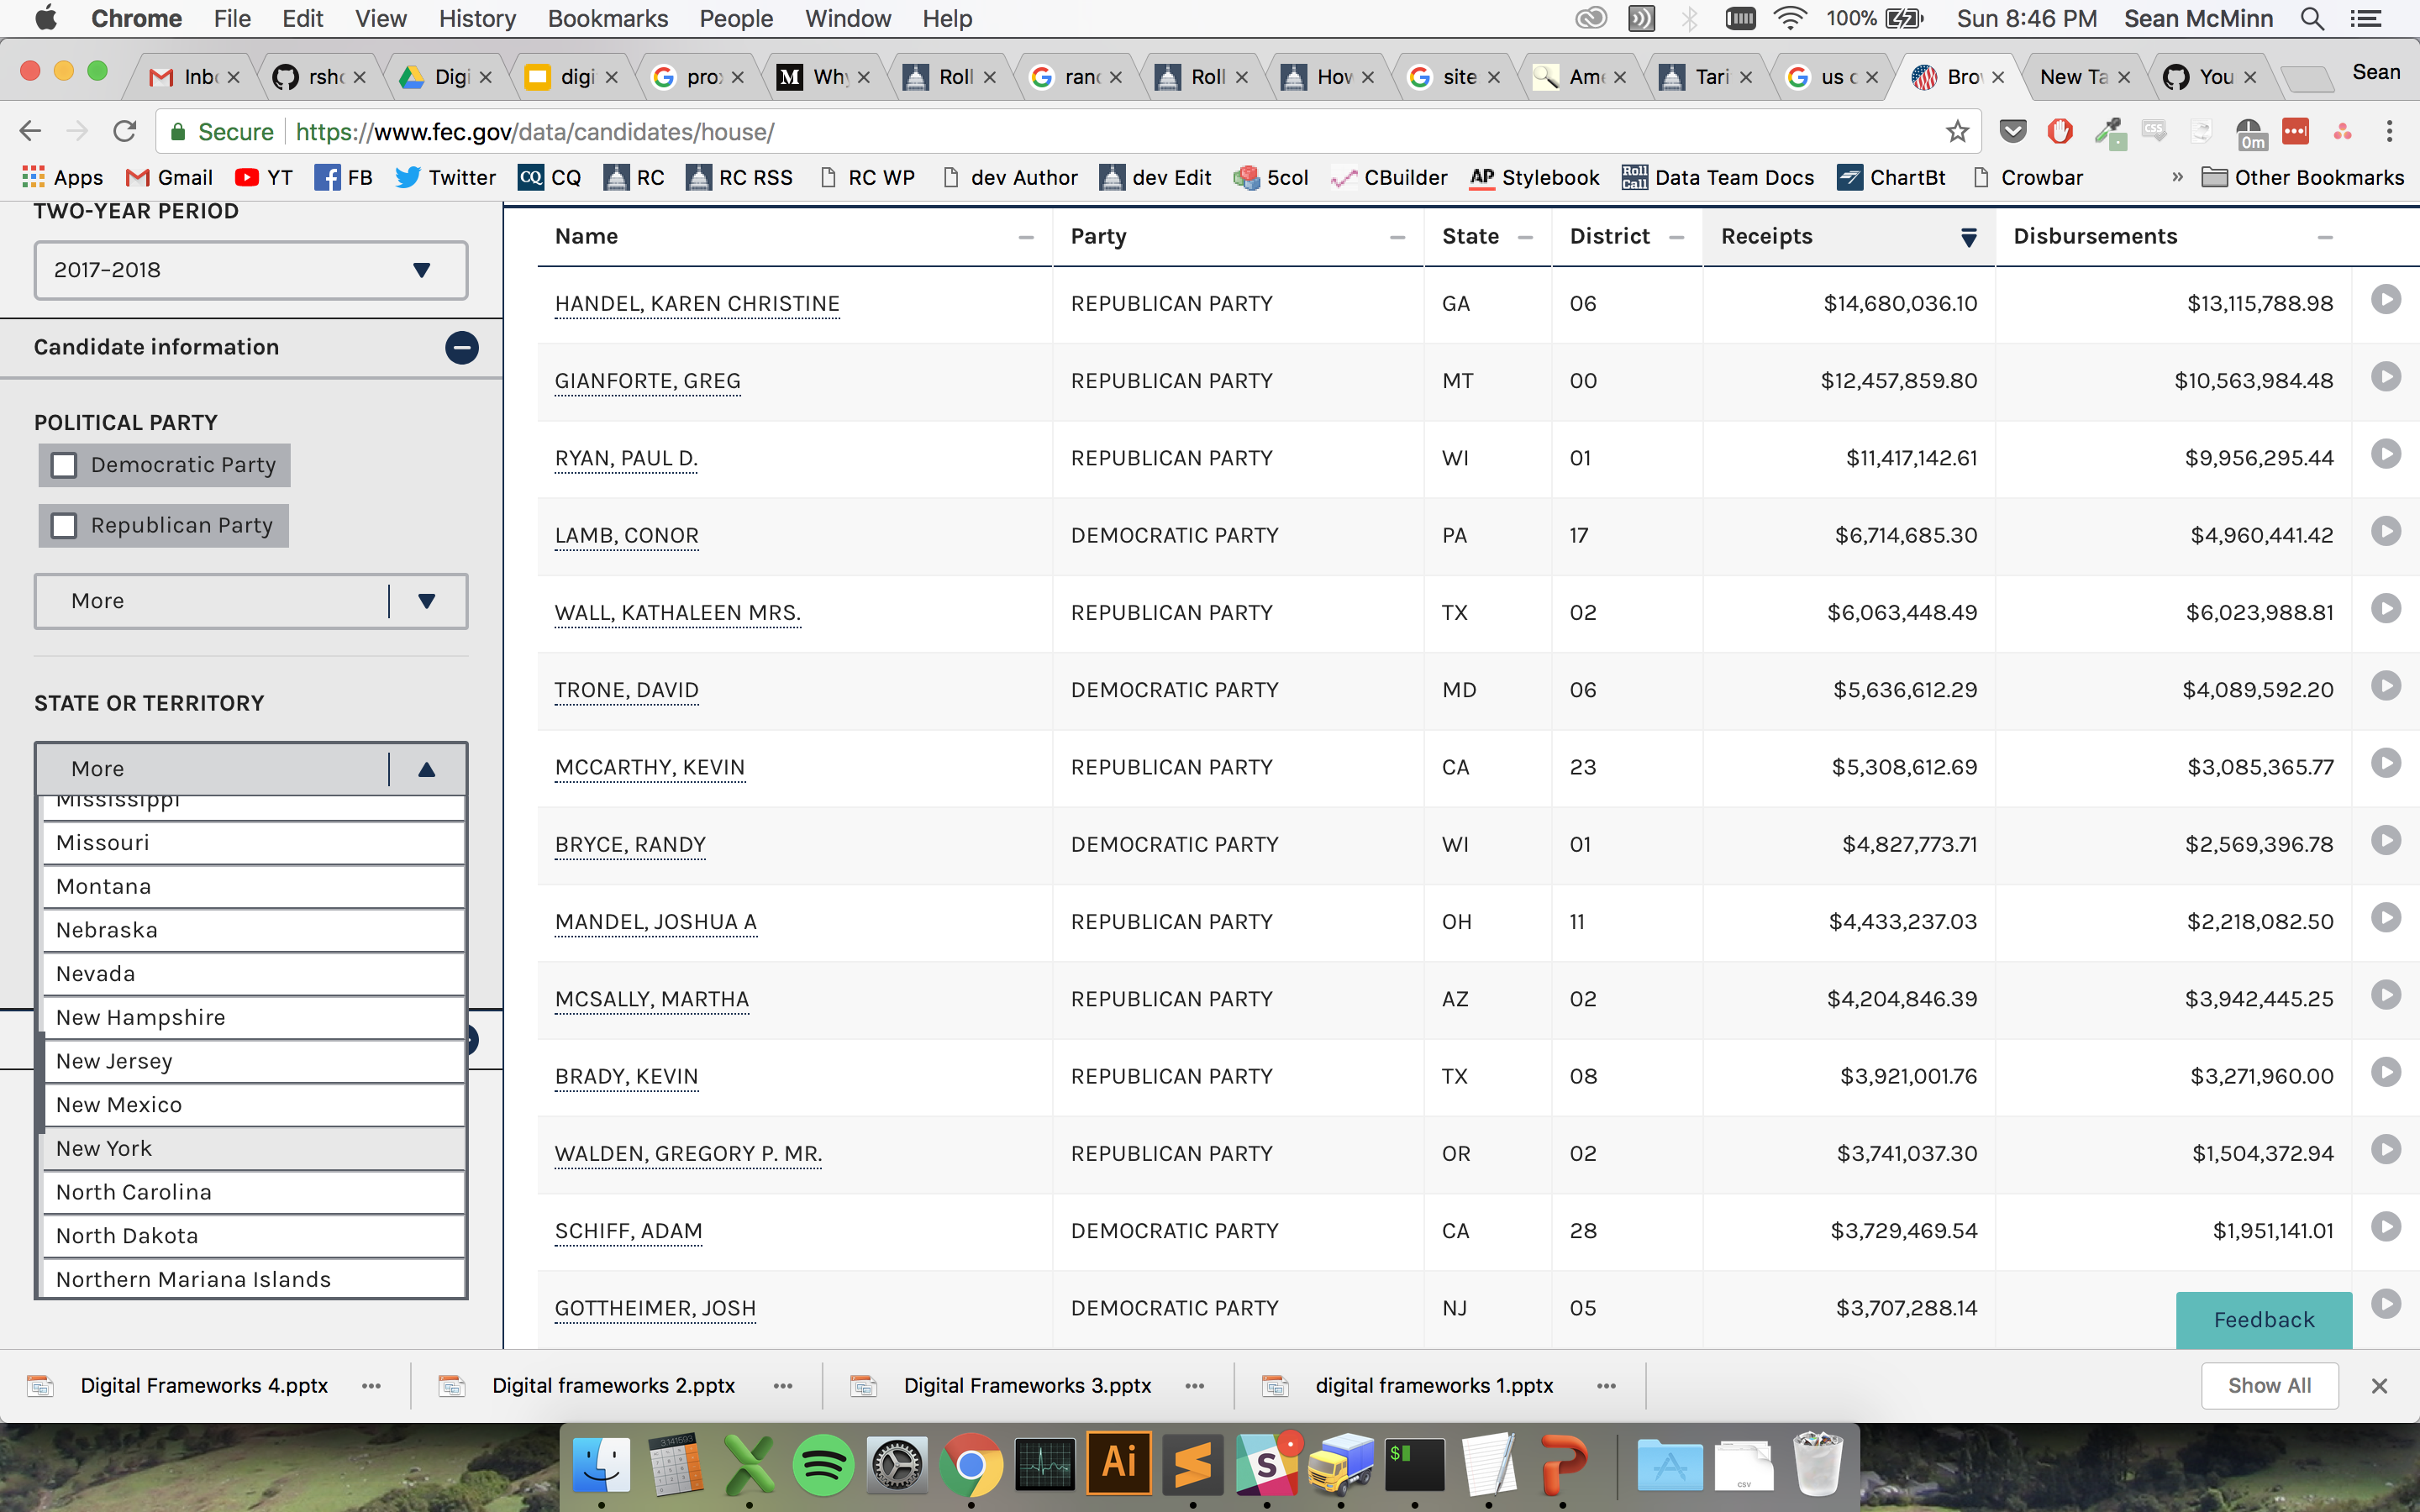
Notes:
They could have used this fun FEC interface, where you go and click a drop down for the state, and then another one for the district. And then they would have had to download a separate spreadsheet for each race.

Slide 16

Notes:
But who has time for that on deadline? This reporter could have just written a story based on old data, which was already analyzed by a think tank, and called it a day. But he called in our data editor, and what do you know …

Slide 17
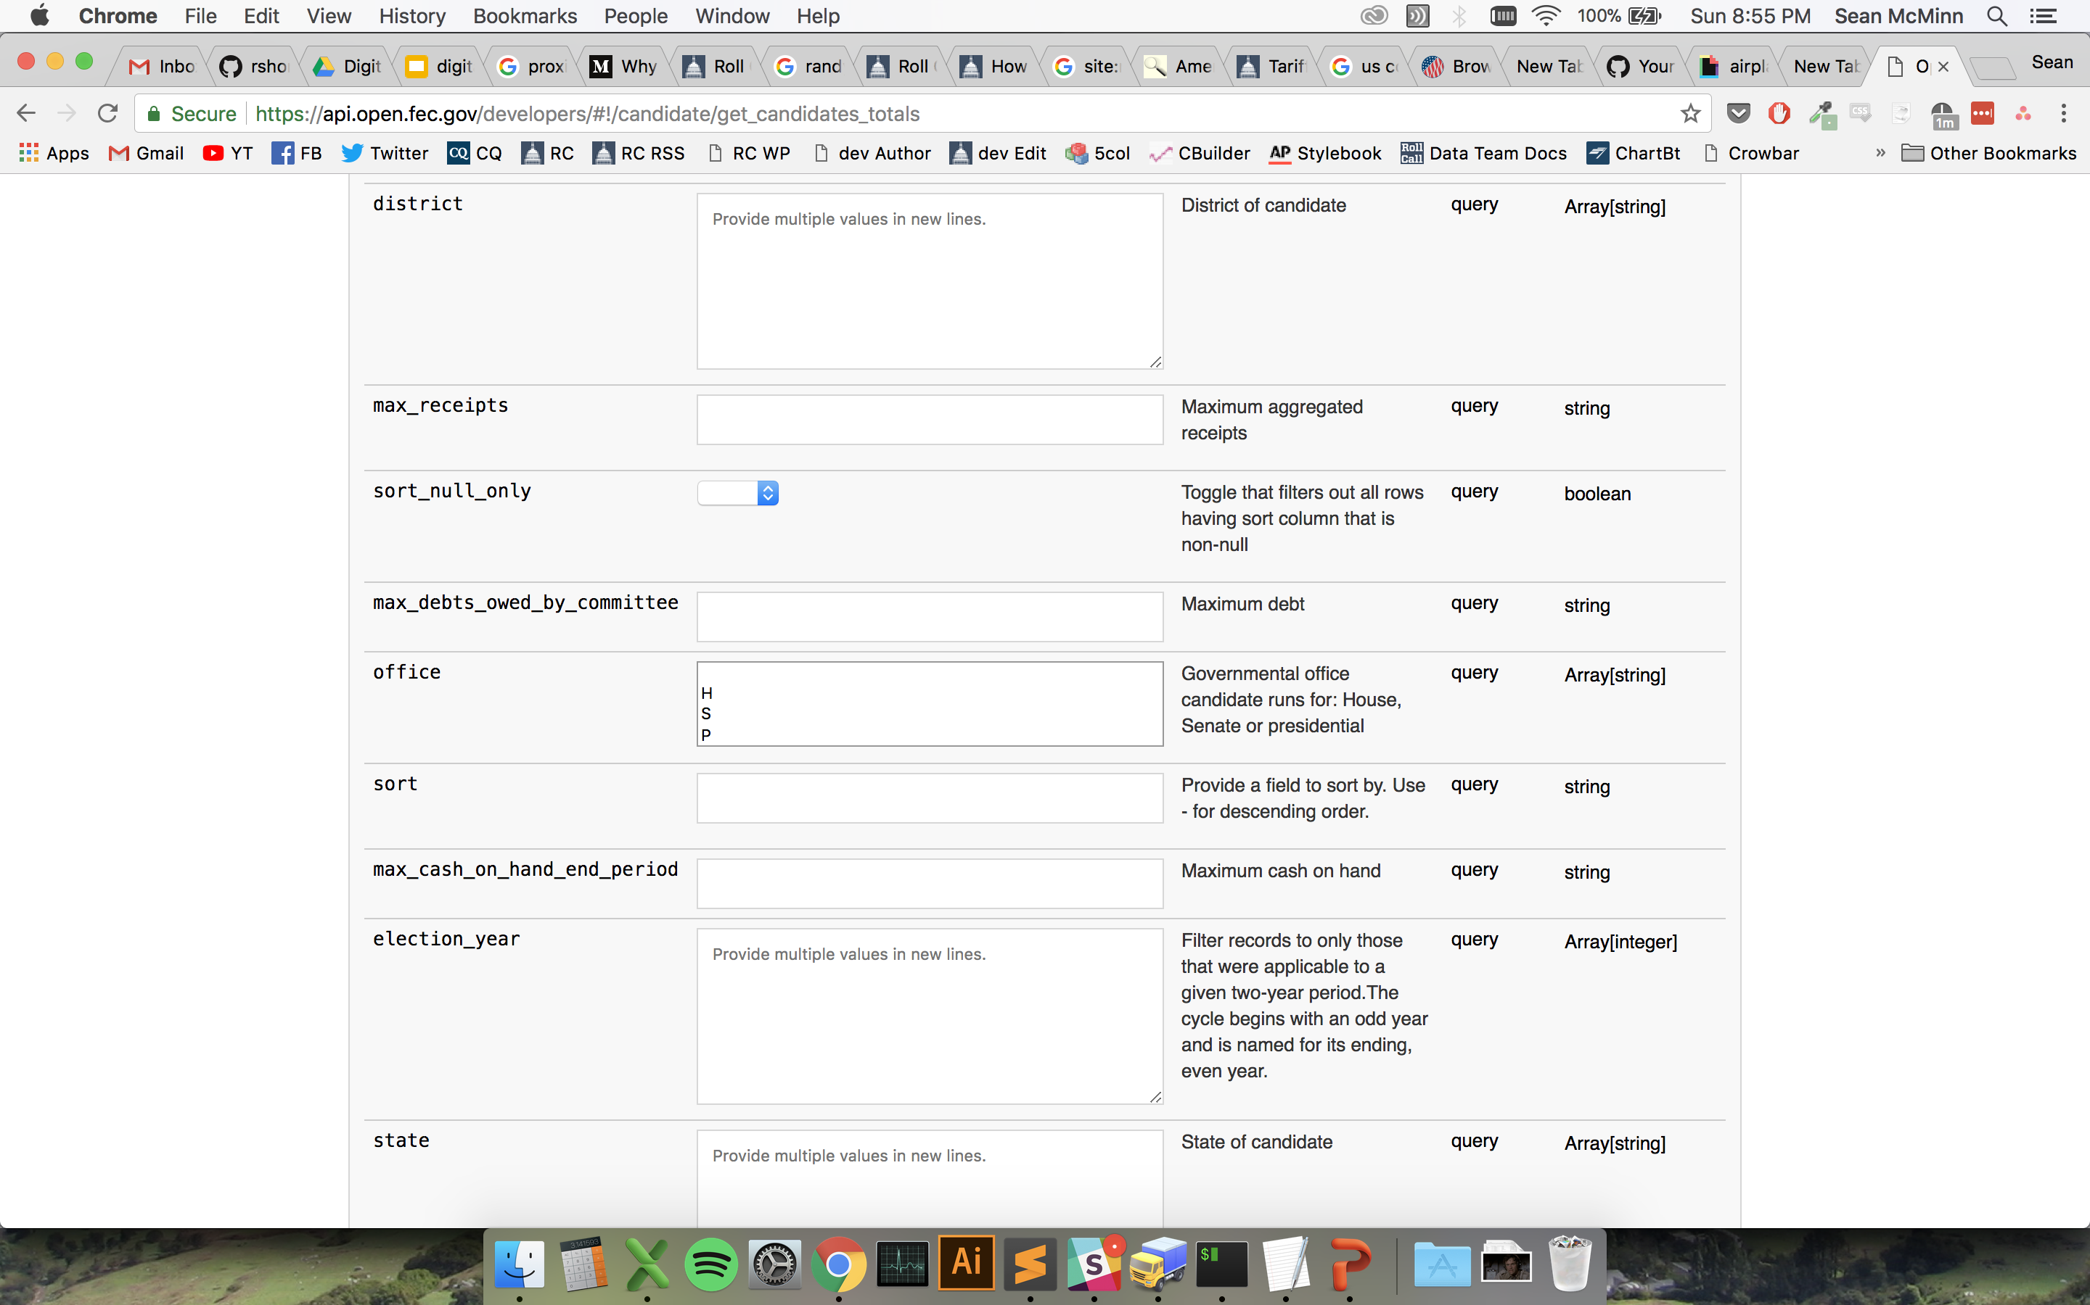
Notes:
There was a better way! The FEC has a whole interface just for programmers to go and get it’s data, and it’s super straightforward.

Slide 18
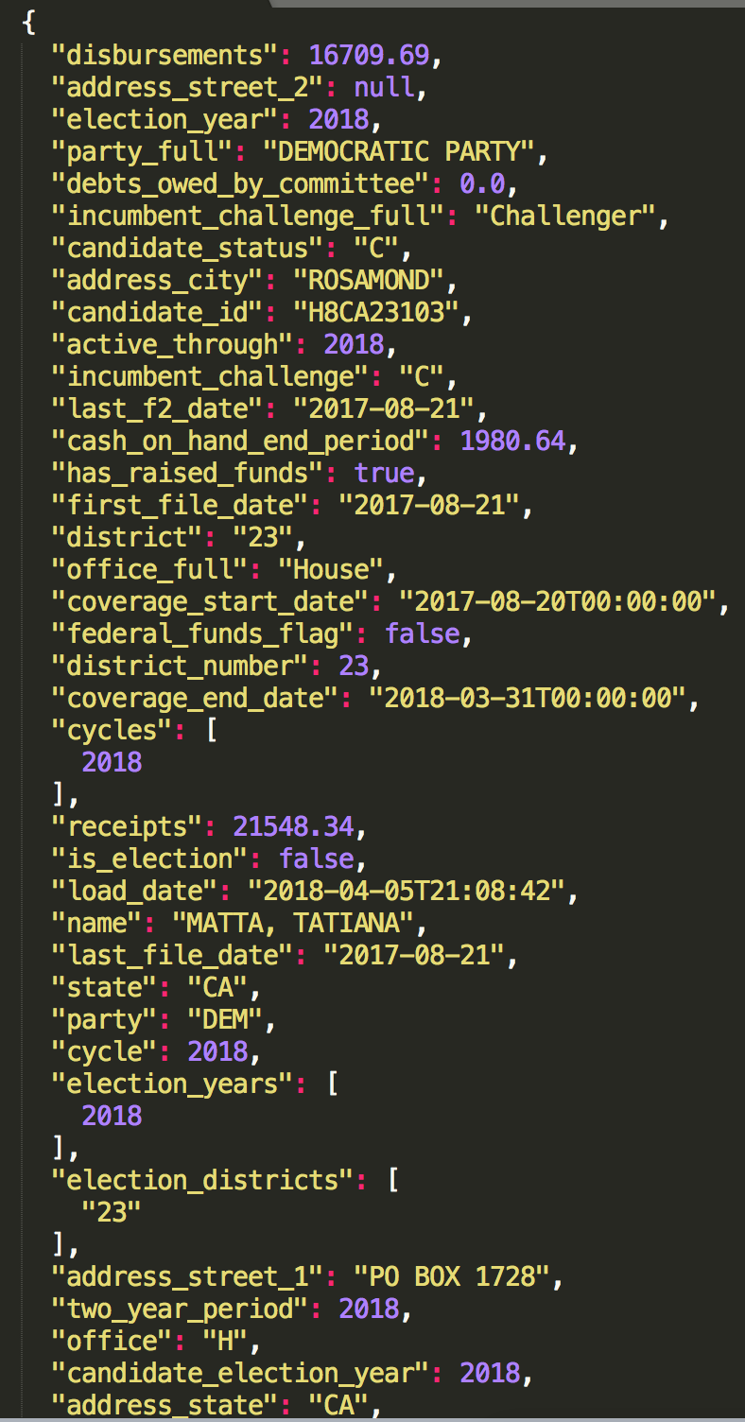
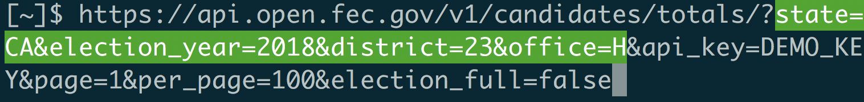
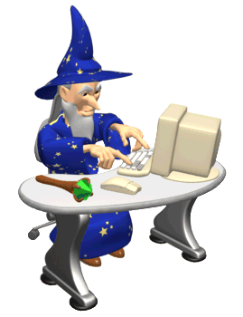
Notes:
You just go to a url that asks for the data you want, and like magic, it’s there.

Slide 19
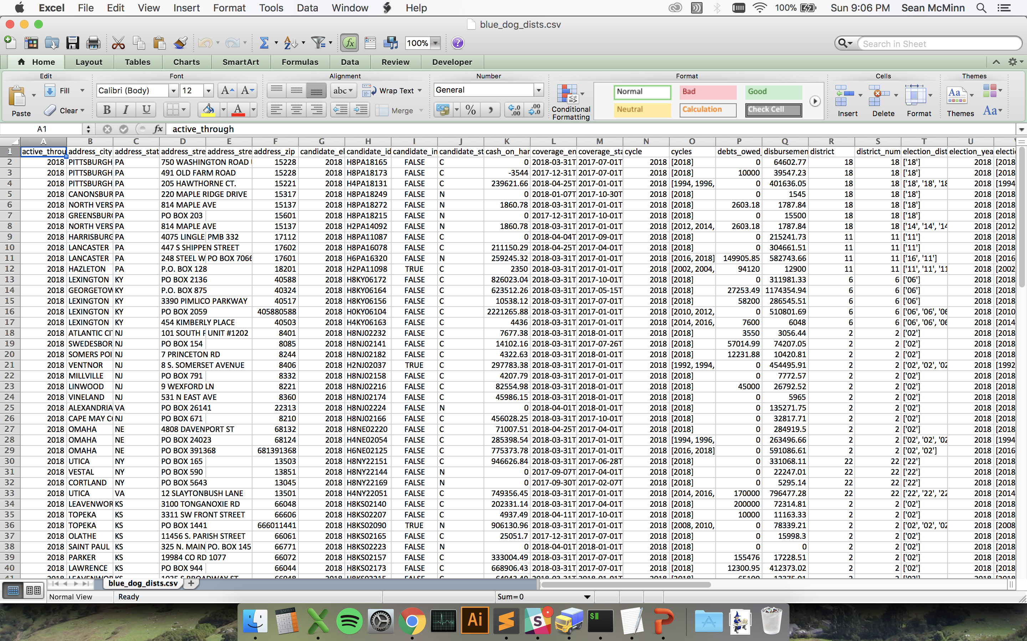
Notes:
20 minutes later, we had a spreadsheet with 3,198 cells filled in. I sent that off to the visual reporter to make a graphic and the reporter to help flesh out his story.

Slide 20
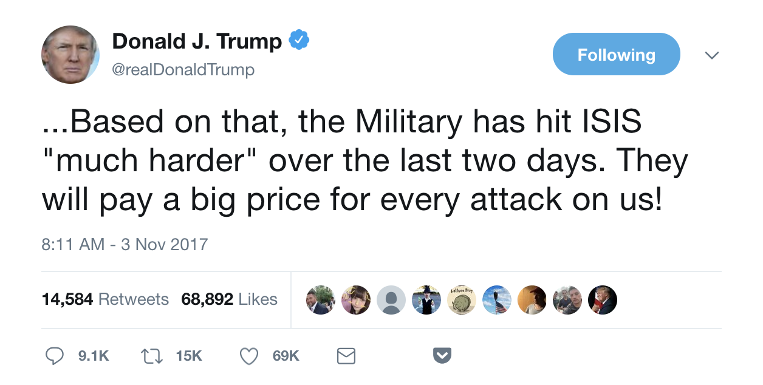
Notes:
Here’s another one. You may remember this tweet from last year, when the president said we were hitting ISIS “much harder” after an attack in New York City. The president has a tendency to … exagerate .. So we wanted to know if this was true

Slide 21



Notes:
As far as I could tell, the Defense Department doesn’t have a database online of strikes against the Islamic State, but it does put out these press releases every day. They’re pretty much just copy paste jobs with the numbers and locations changed, so that seemed like a great project to tackle with web scraping

Slide 22
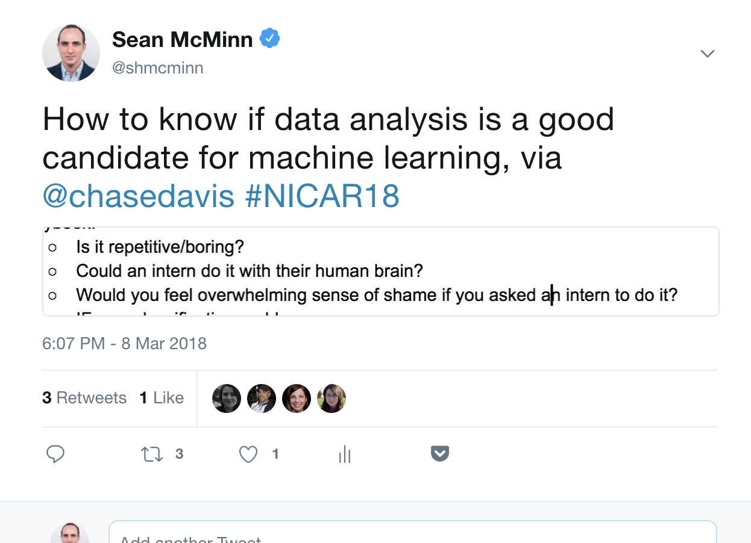
Notes:
I think this applies to web scraping too, even if you’re not using fancy pants machine learning

Slide 23
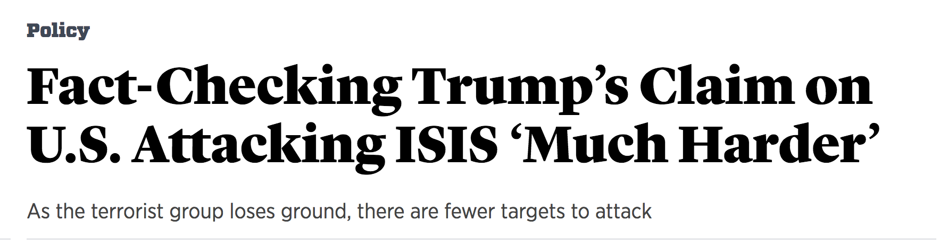
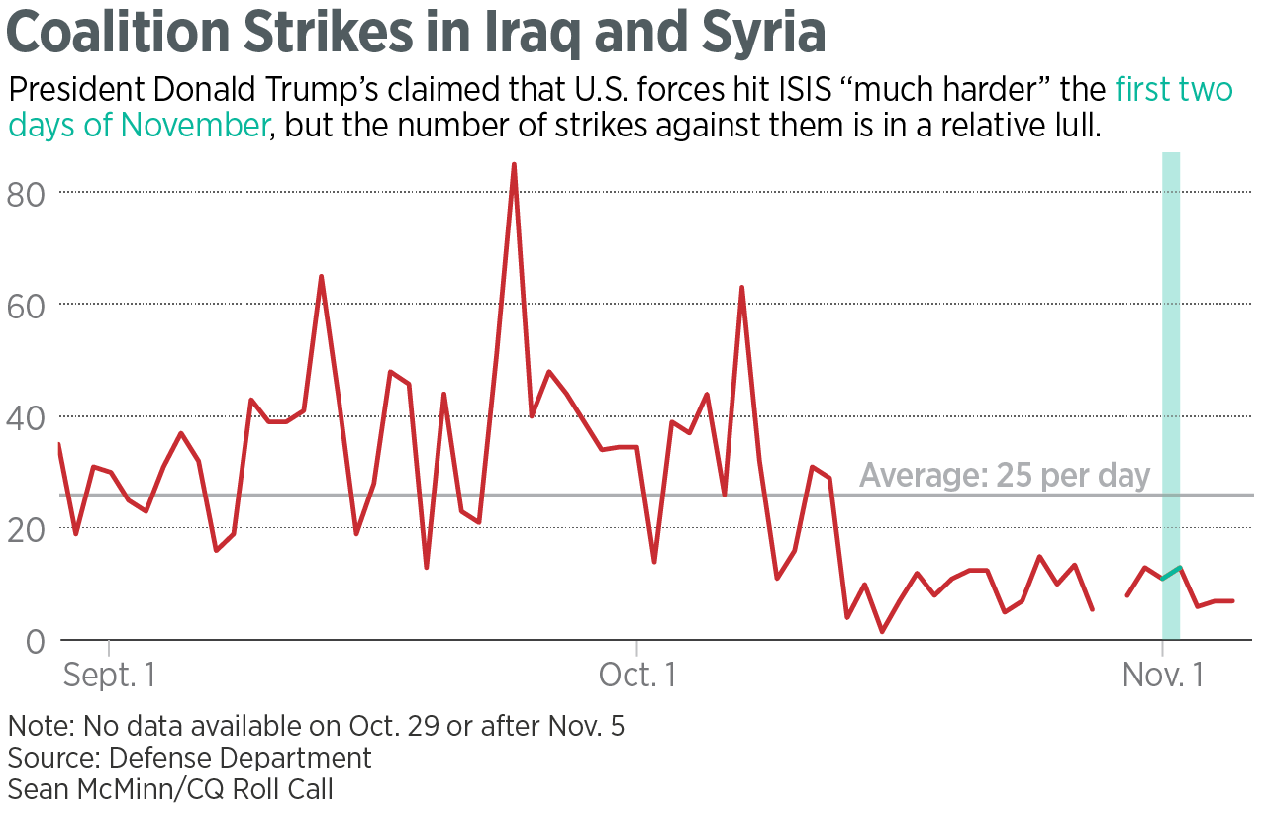
Notes:
So I wrote code that looked for patterns in the press releases, and when it found the text I wanted I had it stick it into a spreadsheet. We ended up publishing this article and making this chart, showing that the president wasn’t being the most truthful.

Slide 24
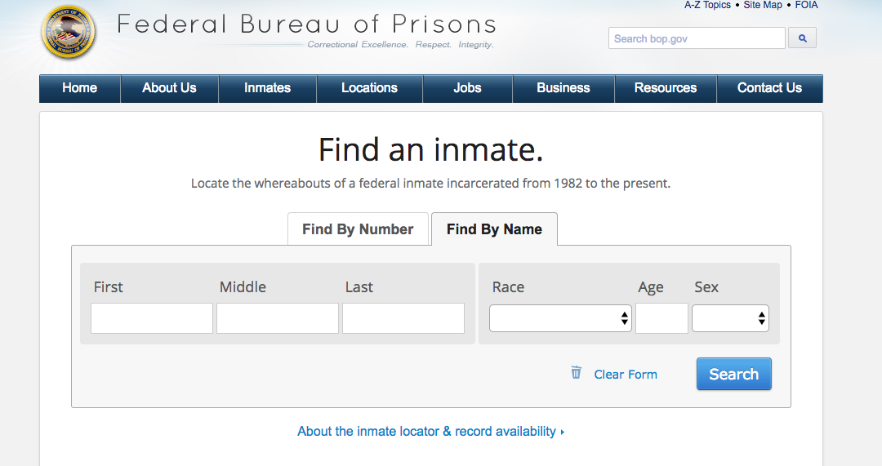
Notes:
The bureau of prisons makes it possible to locate an inmate. One at a time.

Slide 25
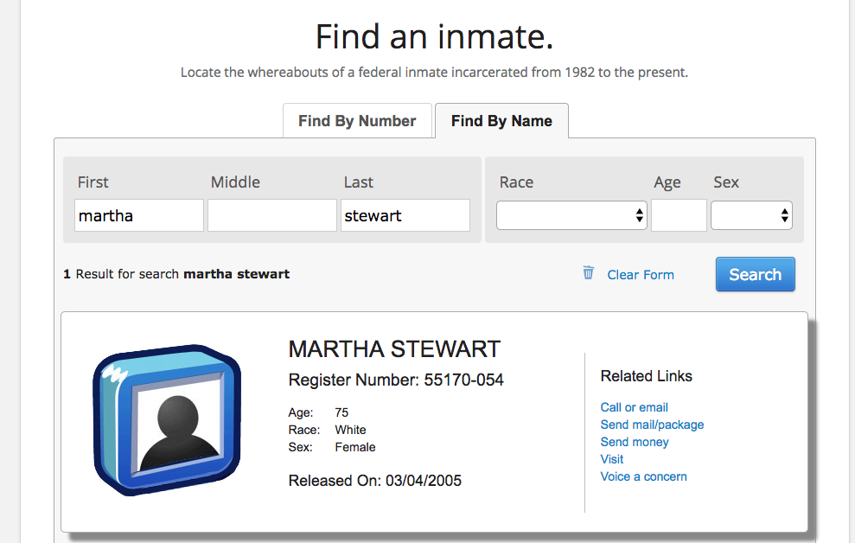
Notes:
To search for a person, a reporter would have had to manually enter each name into this interface. And she would have had to do multiple searches for anyone with compound or hyphenated last names, because those names were sometimes ambiguously recorded as last names.
This reporter had a list of hundreds of people who had been convicted of terrorism in the US. She needed to know which ones were being held on US soil. Many had 3 or 4 names, so this search would have been incredibly difficult.

Slide 26

Notes:
Thankfully, this reporter recognized that her problem could be solved with the application of a bit of software nerdery

Slide 27
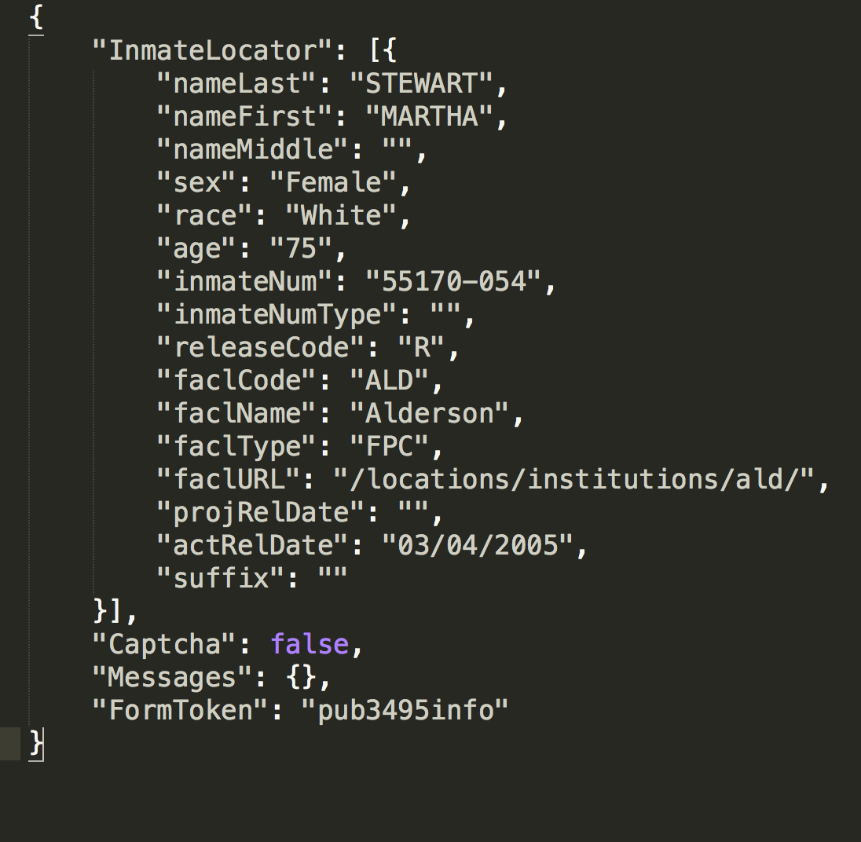
Notes:
The friendly local software engineers discovered the structured data behind this website. Turns out it was very easy to get the data out automatically, in a structured format our coders could quickly process, meaning we could do hundreds of searches, including searching multiple variations of the same name. The reporter could return to the task of calling government offices and asking for information.

Slide 28
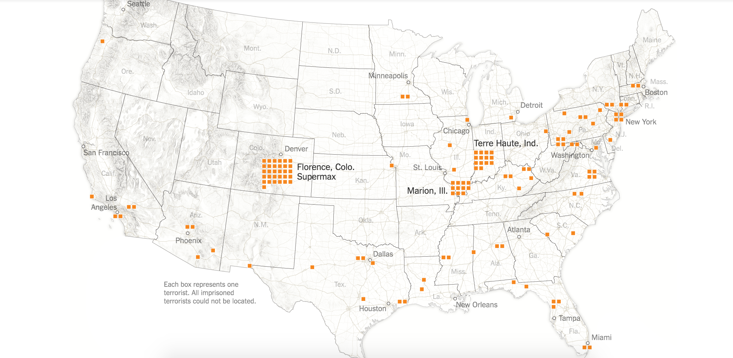
https://www.nytimes.com/interactive/2016/04/07/us/terrorists-in-us-prisons.html
Notes:
The data turned into a map, and an accompanying story, about who ends up on US soil versus in Guantanamo. Using the information gathered quickly from this interface, we were able to counter a narrative about national security practices.

Slide 29
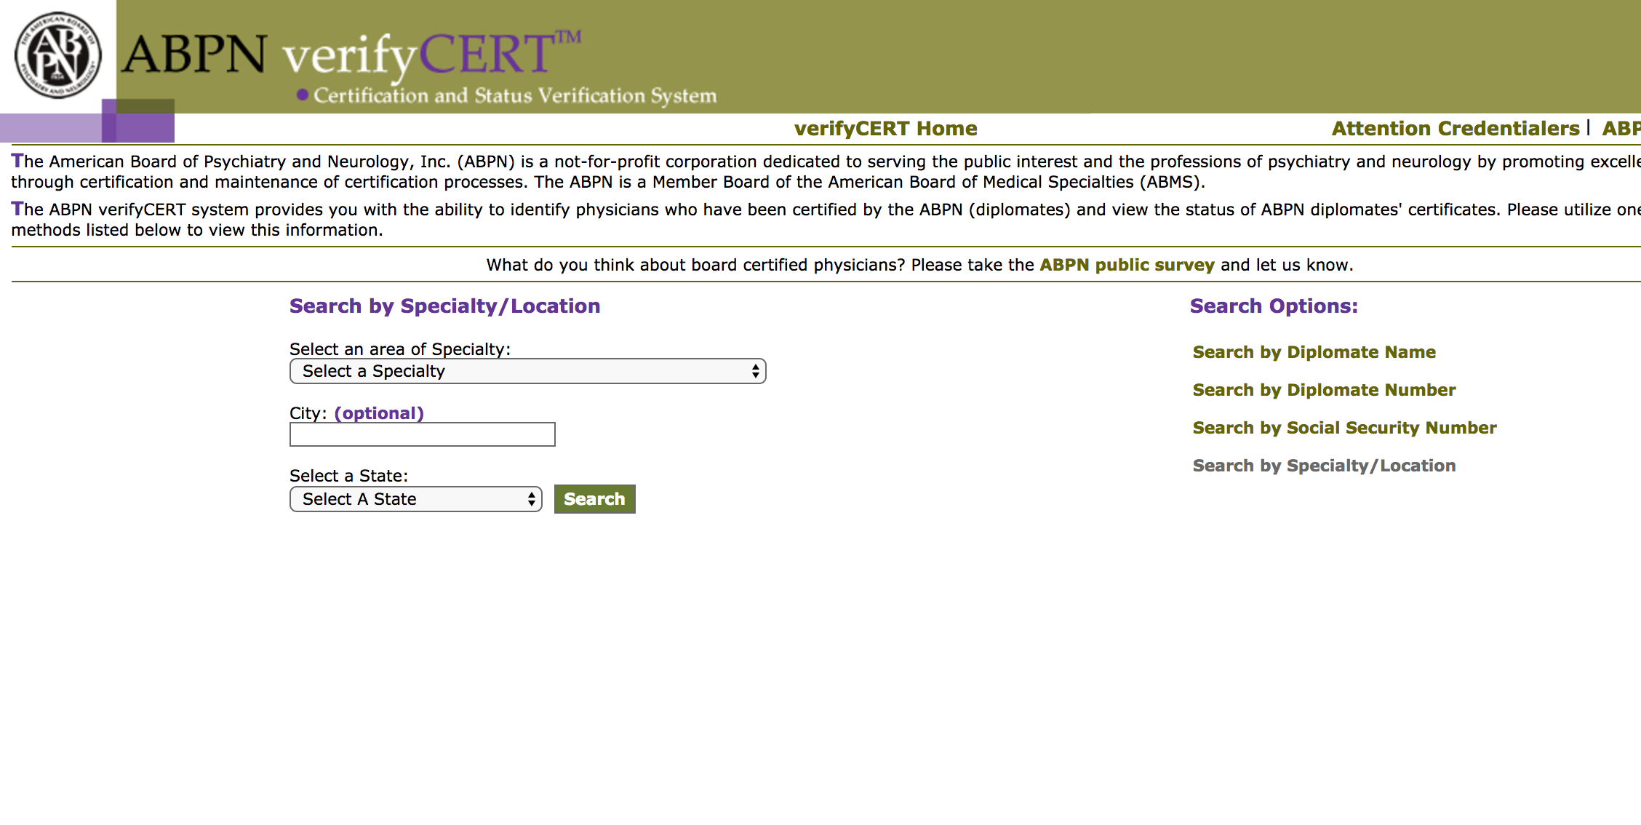
Notes:
Here’s another one. A doctor testified in court, but his name was redacted. But some details were available: his date and place of certification, and some additional biographical information. A reporter discovered that there’s a lookup tool to search for psychiatry and neurology certifications, but you can’t search by date - you can only get lists one specialty and state at a time. He was stuck.

Slide 30
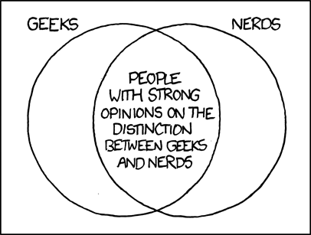
Notes:
Thankfully, this reporter knew the phone numbers of a few friendly local software nerds! This call went to my colleague Jeremy Bowers.

Slide 31
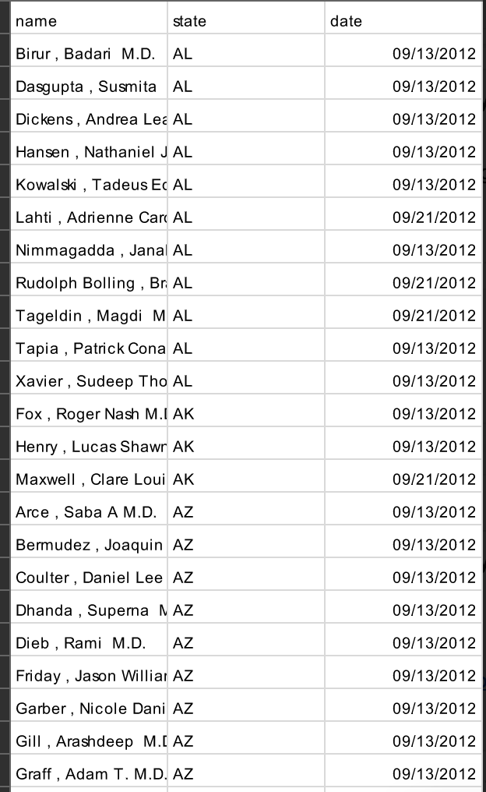
Notes:
The nerds pulled down all the data from the site, including date. So the reporter could sort and search by date, and find the candidates. There were around 900 of them where the date and state both matched.

Slide 32
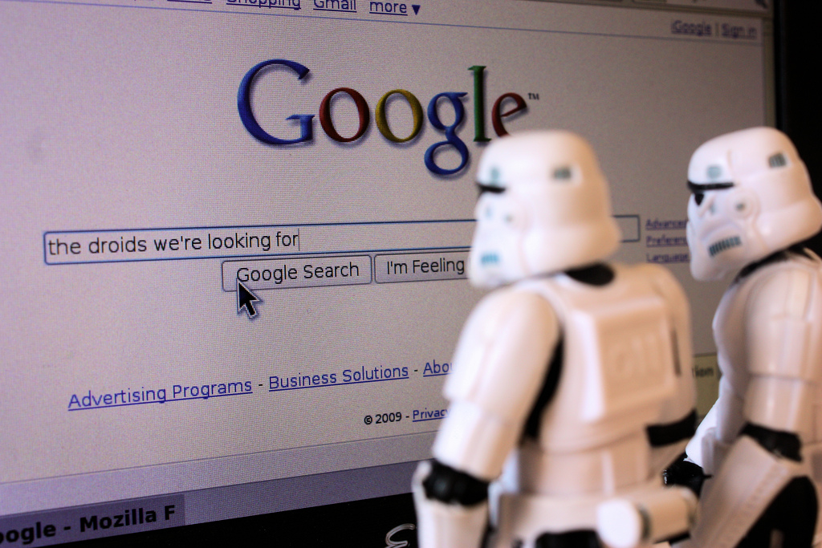
Notes:
Then the reporter turned to google. He made it through 88 before he found one who matched other biographical details in the testimony.

Slide 33
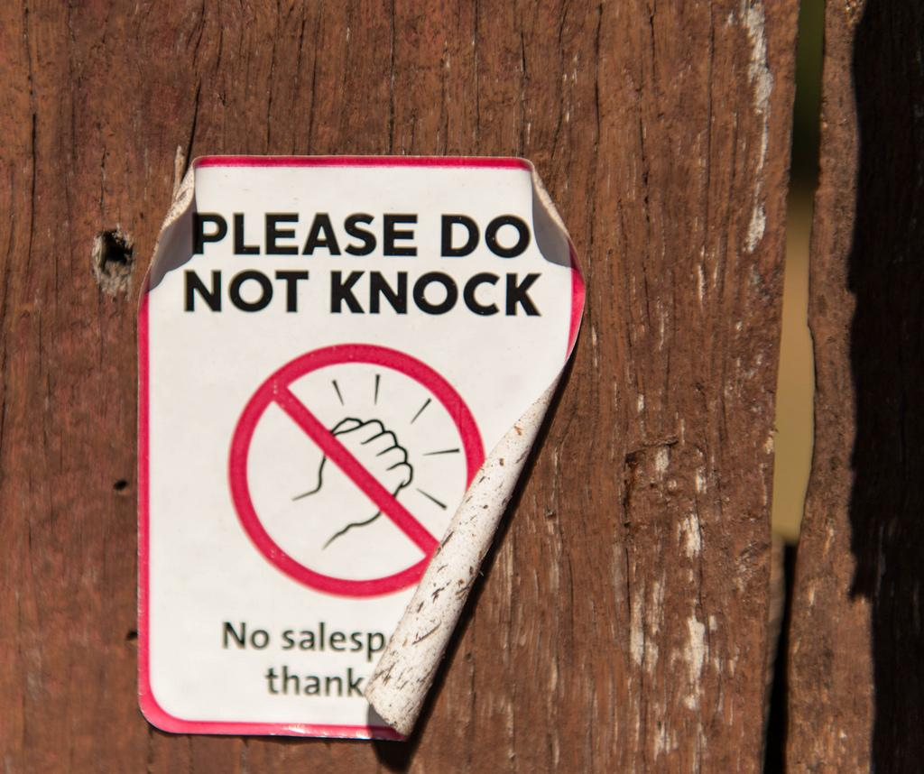
Notes:
Then the reporting team went and knocked on the doctor’s door, and got an hour-long, on the record interview!
This is really a story about something that can only be done with true programmer-reporter collaboration. Not only did the reporter need to recognize this opportunity, he needed to put in the effort to narrow down the 900 person list. But without the assistance from the programmers, there would be no list to narrow.
The match in the end was confirmed by a linkedin page that contained some other professional details listed in the testimony.

Slide 34

https://www.nytimes.com/2016/11/13/world/guantanamo-bay-doctors-abuse.html
Notes:
The interview went on to be part of a five part series on torture at gitmo. This is a case where the data is not an obvious part of the final story. The data component helped the reporters find the story. I love sharing the stories behind stories like this, because this is a true example of how programmers can contribute to the newsroom in nearly invisible but very important ways. There is no quote-unquote data in this article - it’s almost entirely interviews and anecdotes.

Slide 35
Once upon a time...
...the data just kept coming and coming

Slide 36
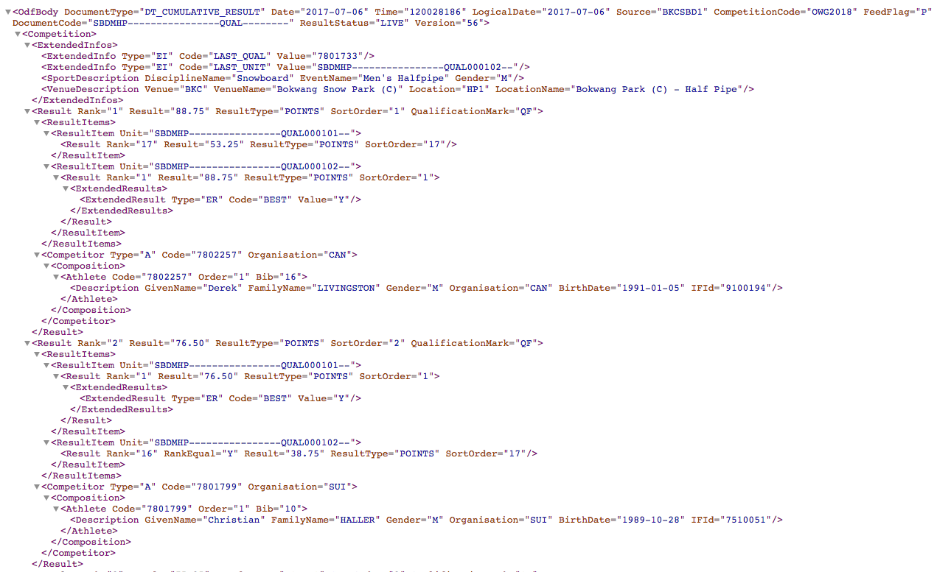
Notes:
Folks who work with datasets often encounter datasets that look like this (can anyone figure out what this event is?) During busy competitions, we can get 20 messages a second.

Slide 37

Image form wocintechchat.com
Notes:
In this case, no one passes go, no one collects $200. They call in the nerds immediately! Huge amounts of the Times’ Olympic coverage is powered by two newsnerds sitting in a press tent in the city. My colleagues Michael Strickland and Scott Blumenthal were there in Rio. Our team keeps a collection of olympic mascot dolls. We power graphics, we get reporters the most accurate times, we answer questions.
In fact, Michael just spent a week in South Korea starting to prepare for next year’s winter olympics. The newsnerds from around the world who run different organizations’ olympic feeds are required to participate in massive testing exercises as part of their data contract with the games, starting nearly a year in advance. So if you enjoy seeing splits or knowing how two performances compare second-by-second, hug a newsnerd.

Slide 38
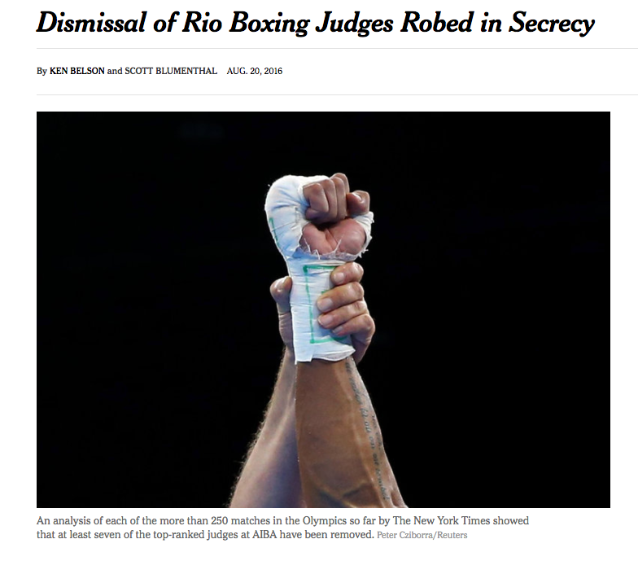
https://www.nytimes.com/2016/08/21/sports/olympics/boxing-judges-dismissal-robed-in-secrecy.html
Notes:
This is one of my favorite stories from Rio. One reason it came about is because Scott Blumenthal, one of the Rio nerds-in-the-press-tent, is a big boxing fan, and was paying close attention to the sport. He had been chatting with the reporter covering boxing for weeks in advance, so after some complaints about boxing judges, he was very prepared to work with the reporter to dig in and see if they could find anything abnormal. And what they found is that several judges just...disappeared! They weren’t judging any matches anymore, but there was no announcement. The nerd+reporter combination figured out who they were, what their ratings were, and when they stopped judging. They figured out what was happening behind the scenes based on the data, despite the lack of announcement from the sport’s governing body. The moral of this story is that if you’re just hoping to make an olympic problem go away, beware of the nerds.

Slide 39
Once upon a time...
...the open government data was in an adversarial format

Slide 40
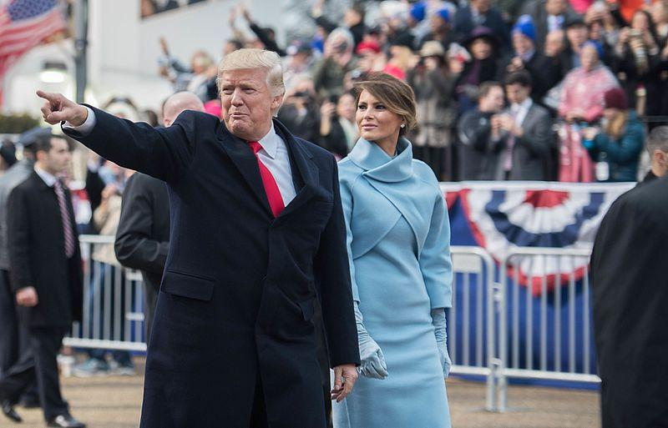
Notes:
As you may or may not be aware, we had a major event in Washington this January - a presidential inauguration! Unfortunately, after the party comes the bill. The cost is covered by fundraising from the Presidential Inaugural Committee, which must release a list of its donors.

Slide 41
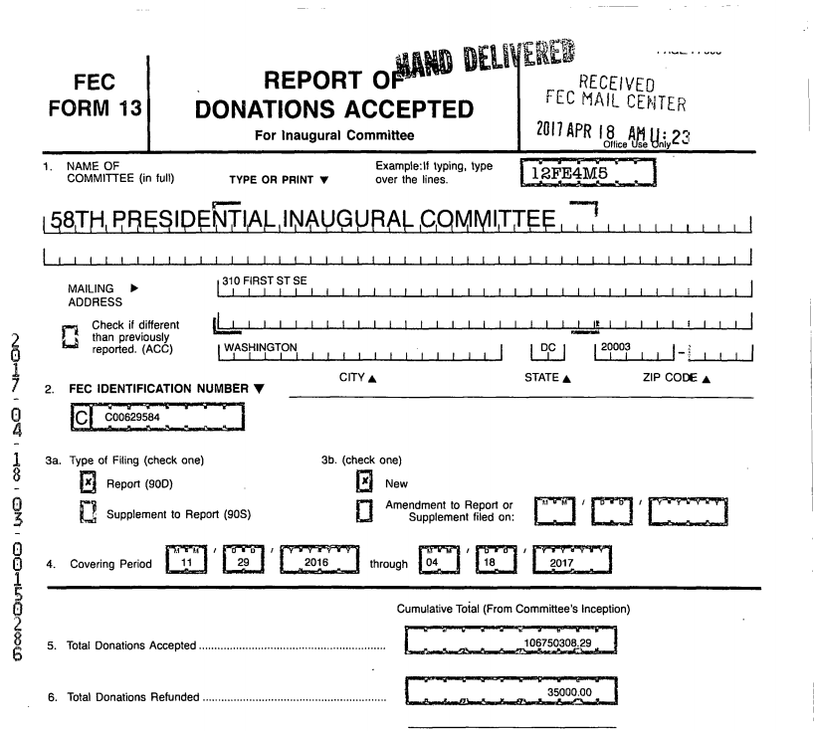
Notes:
The Presidential Inaugural Committee provided a report of donors to the Federal Election Commission.
How did they release it? They hand-delivered a printed out PDF to the FEC. The FEC stamped it, scanned it, and put it online. (Just to be clear, it’s not like they used a typewriter to fill out this form, they used some user-friendly software and then hit the “print” button, not the “send to FEC” button. This was their choice, not a mandate - past inaugural committees sent electronic, machine-readable data).

Slide 42

Image from wocintechchat.com
Notes:
“Find me a nerd!”
Unfortunately, the sad story here is that the nerds just aren’t that much better than anyone else. This data is pretty badly locked up. And we knew it. So we combined our nerd-powers.

Slide 43
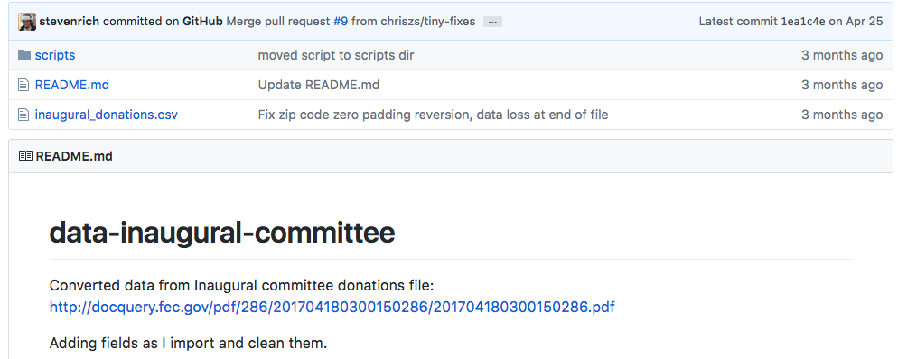
Notes:
A data editor named Steven Rich from the washington post started manually cleaning the filing in public

Slide 44
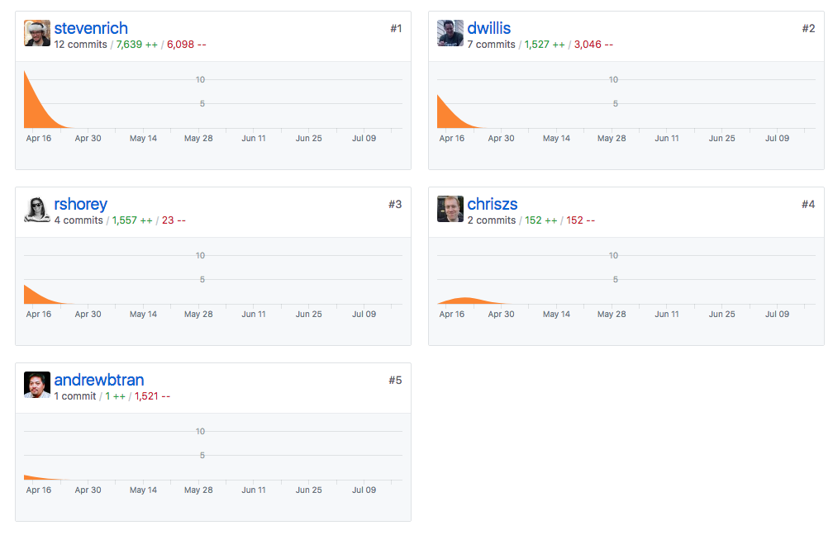
WaPo
ProPublica
NYT
Center for Public Integrity
CT Mirror
Notes:
Nerds from 5 different news organizations contributed

Slide 45
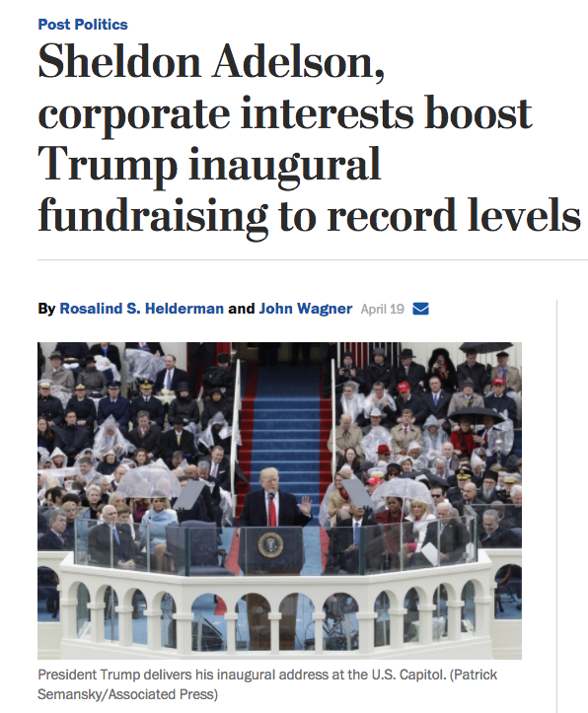
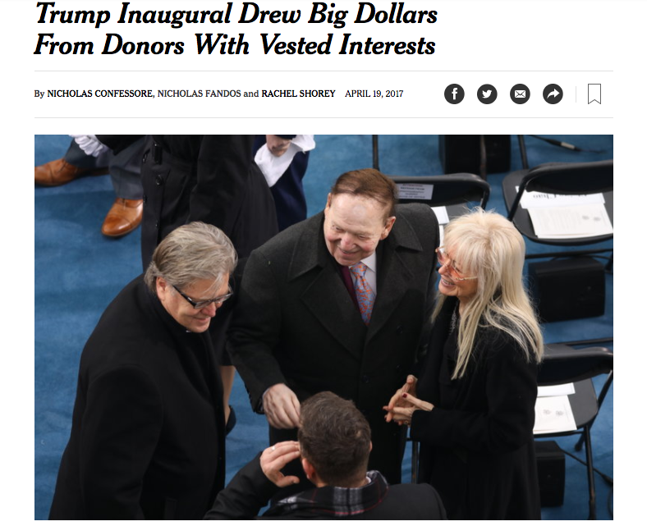
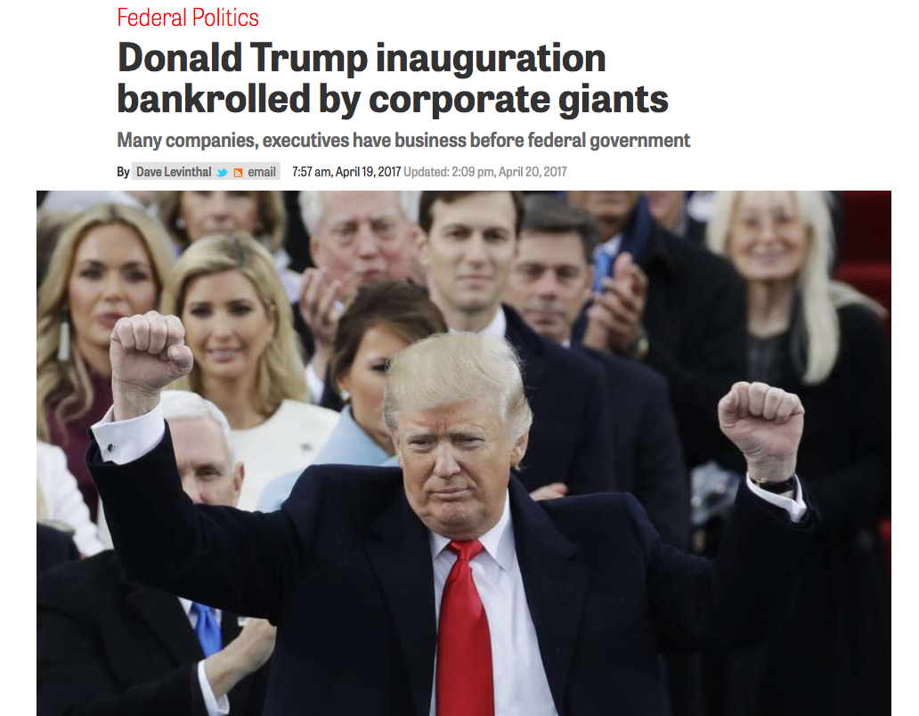
New York Times
Washington Post
Center for Public Integrity
Notes:
Everyone wrote a story. The news organizations didn’t collaborate on their reporting directly, we collaborated on the part that everyone was going to have to do as a prerequisite to the reporting anyway.
The saddest news (for the nerds) is that some of these stories discovered problems with these filings. So the committee had to file an amended version of the report, several months later. Do you think they filed that one electronically? Nope. So the whole painful multi-day collaboration had to start over again.

Slide 46
Once upon a time...
...the structured data was hiding

Slide 47

Notes:
Perhaps you have heard of this guy. He wrote a play about some guy named Hamilton, and apparently people liked it.

Slide 48
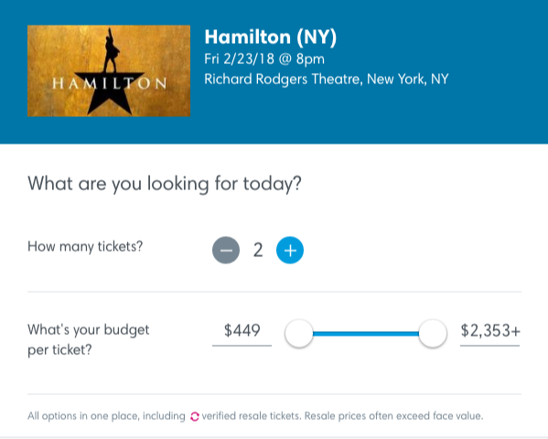
Notes:
They liked it so much that tickets were going for thousands of dollars (to be clear, even though it says 2 tickets, this is the price per ticket). One big problem was the resale market. And part of the reason for that was that the resale companies were using bots to buy tickets. If only we could figure out how to monitor sell out dates and costs! (bet you can’t guess what’s coming next!)

Slide 49

Notes:
Call in the nerds! My colleague Tiff Fehr basically wrote a ticket-buying bot. But instead of buying tickets, it just checked inventory and price. It turns out a lot of people at the Times were interested in this data, given how popular Hamilton tickets became.

Slide 50
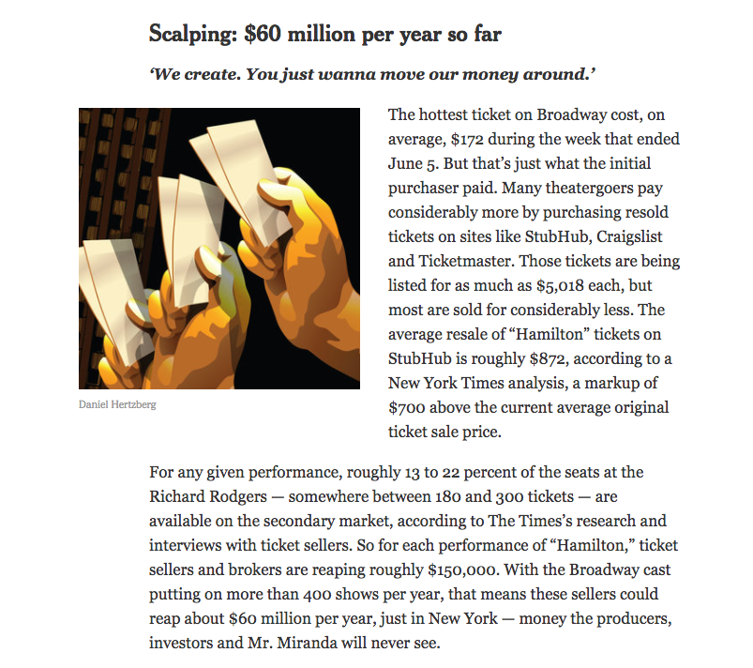
https://www.nytimes.com/2016/06/12/theater/hamilton-inc-the-path-to-a-billion-dollar-show.html
Notes:
By recording the ephemeral data while it was created, Tiff put together a structured data set that helped reporters understand the scale of scalping on Broadway.

Slide 51
The goal of this class is to get you familiar with some tools that will allow you to tell a better story with data….
Notes:
So, what are we really here for?

Slide 52
So you have the tools to feel comfortable if data lands in your lap...
Notes:
specifically

Slide 53
And you are prepared to engage in a conversation about a data and/or technology story...
Notes:
specifically

Slide 54
And you leave this class with an improved BS detector about data/tech stories...
Notes:
specifically

Slide 55
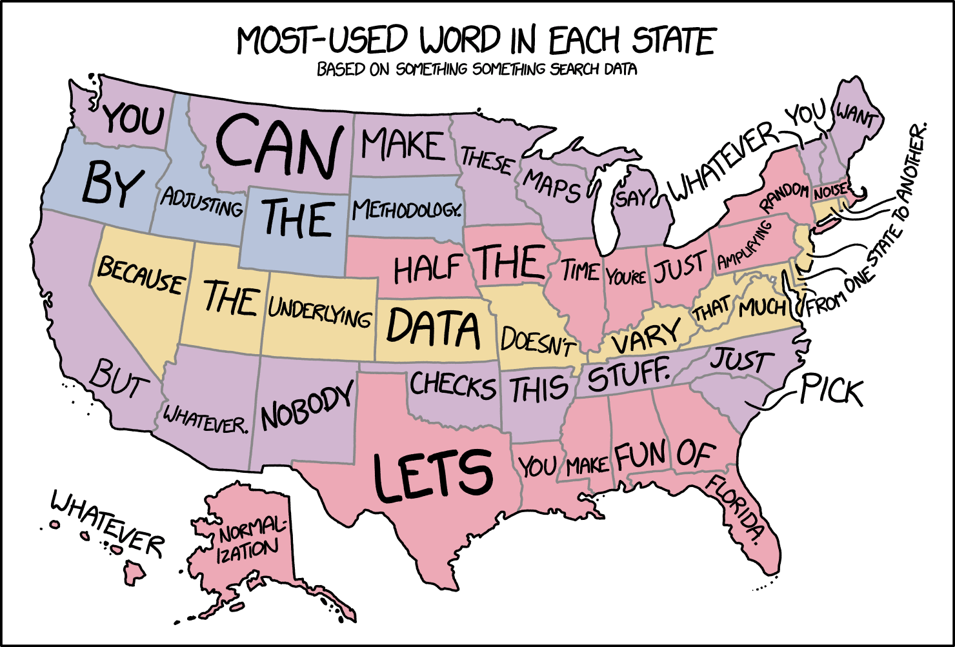
Notes:
I’m definitely moving to South Dakota. Or Alaska. Or Florida.

Slide 56
And you’ve created a portfolio piece based on data reporting.
Notes:
specifically

Slide 57
What will classes be like?
We’ll start class with any examples you all saw during the week that are relevant to the kinds of things we’ve been working on. (In general, you are expected to read/watch/absorb the news)

Slide 58
Data Stories
We’ll start each class with a few data stories you have seen during the week. They could be visuals, text, video, whatever. I’ll generally randomly call on people, so please have one prepared (you should be able to describe it well enough that we can find it by googling and pull it up).
https://www.nytimes.com/interactive/2018/03/30/upshot/crime-immigration-myth.html
https://www.washingtonpost.com/graphics/2018/local/dc-riots-1968
https://qz.com/1242512/we-won-our-lawsuit-against-the-us-government-over-paywalled-immigration-data/
https://www.axios.com/oklahoma-teachers-brace-themselves-6c21da6f-06ef-474c-a2e8-ca84e7d53828.html
https://www.washingtonpost.com/news/dr-gridlock/wp/2018/04/04/more-dogs-die-on-united-than-on-any-other-airline-heres-why

Slide 59
What will classes be like?
Then we’ll do some lecture, possibly with some discussion, the timing will depend on the week.

Slide 60
What will classes be like?
After that, you’ll have an in-class assignment. If you don’t finish (or if you miss class), this assignment is due before the next class starts.

Slide 61
What will classes be like?
Guests! I’ll try to bring some other interesting people working in journalism/data/tech/design.

Slide 62
What are we covering?
The lifecycle of a data story
How do you even get started?
Notes:
Spreadsheets. Don’t underestimate the power of sum-and-sort journalism.

Slide 63
What are we covering?
Collecting and cleaning
Where do I find data?
What do I do with it once I’ve got it?
Notes:
Data formats and big data.

Slide 64
What are we covering?
Using a dataset
Being familiar with data formats
Using spreadsheets!
Notes:
Data formats and big data.

Slide 65
What are we covering?
An example!
Campaign finance data
Notes:
Data formats and big data.

Slide 66
What are we covering?
Storytelling and the design process
An example from the CBC
Also mid-term final project pitch session.
Notes:
Data formats and big data.

Slide 67
What are we covering?
Data visualization
What makes viz bad?
Making it better on deadline.
Notes:
Data formats and big data.

Slide 68
What are we covering?
Cryptography, security and data breaches
What is cryptography
Personal Security
Reporting on security and hacking
Notes:
Data formats and big data.

Slide 69
What are we covering?
While I’ve got you here...
Little things I wish my colleagues knew about data and technology.
Notes:
Data formats and big data.

Slide 70
Final Project
You’re responsible for writing a 1000 word data story by the end of the quarter. We’ll discuss in more detail in an upcoming class.

Slide 71
Policies
Consuming the news
You are expected to find at least one story (written, video, graphic, whatever) each week that uses data or technology in an integral way. Please come to class with a link ready to go, I will ask a few students at random to share a story they found. This will contribute to your participation grade.

Slide 72
Policies
Grading:
Participation/attendance: 20%
In class assignment (becomes homework if you don’t finish): 50%
Final project: 30%
(this is all on the syllabus)
Notes:
To be totally clear about this: I know you need to get at least a B in this class for it to count. Let’s talk about the ways to get there:
*you could never show up in class (except to present your final project), but you’d have to be 100% perfect on your assignments
*I plan to assign 7 assignments, You could fail to turn in 3, hope I’m inclined to round up, and be perfect on everything else.
*You could do a miserable (but not zero) job on your final project and be perfect on everything else
PLEASE DO NOT DO ANY OF THESE. I really don’t want to give you a grade that will get in the way of your graduation. I know you are busy with internships, so the workload in this class is designed to be reasonable. If you show up to class, turn in your assignments on time and put some effort into your final project, you’ll get the grade you need easily, it won’t overwhelm you, and you’ll learn some valuable skills.

Slide 73
Policies
Grading:
Class assignments are due before the next class.
I will not accept these assignments late. You should be able to finish them in class, an extra week after that gives you plenty of time
I am aware you need to get at least a B- for this class to count towards your degree. If you miss 3 homework assignments, it’s impossible to get a B-, even if you get 100% on everything else. Please do not do this.
Notes:
I will do everything in my power to help you pass this class with at least a B-, but I can’t make up assignments you didn’t turn in.

Slide 74
Policies
Grading:
Unless otherwise noted, assignments should be written in sentences and paragraphs (not bulletpoints, fragments, etc)

Slide 75
Policies
Submitting assignments:
Assignments must be submitted on Github. We’ll go into details about how and why later in this lecture. Working on Github is an important skill I want you to leave this class with, so I will not accept homework submitted any other way.

Slide 76
Policies
Collaboration:
Students are encouraged to discuss assignments. For the most part, you will be working on different things, so talking about your work should not be a problem. Whiteboarding your way through a sticky problem with a friend or looking online for answers to technical questions are encouraged (programmers do that all the time!) Your final work, however, must be entirely your own. A good rule of thumb is that no one else should take over your keyboard while completing an assignment. Ask if you aren unsure.

Slide 77

Github
Notes:
For the remainder of this lecture, we’ll be talking about github. It’s where you’ll submit your homework, and where your final project will go.

Slide 78
Github
I often hear people say that github is easy. These people fall into one of three categories:
People who only know about a very small number of features
Developers at Github
Liars
Notes:
I tell you this not to intimidate you. We’re mostly going to be in category 1 here. I’m telling you this because I don’t want groups 2 and 3 to intimidate you away from using it and asking questions. Github is important to understand for reasons we’re about to discuss, and it is important that you know that it is hard for people who have been using it for years, so you should not feel stupid or intimidated if you get stuck. Everyone started from scratch once, and if anyone is nasty to you about it, they’re a lying asshole.

Slide 79
Github: What is it
Collaborative
Distributed
Version control

Slide 80
Github: Collaborative
A team of people can work on the same project together. If the project is open-source, anyone can contribute (but there are protections)

Slide 81
Github: Distributed
We can work at the same time on the same thing, and resolve conflicts later. We can even maintain multiple versions of the same code or document. You can easily work while offline.
Notes:
Have you ever been in google docs and seen other people add and delete stuff above you and things jump around? Yeah, Github prevents that.

Slide 82
Github: Version Control
You get to plant flags (called commits) and it saves a copy at that point. So you never have to title a file story_RS_v2_06212017_3PM_v3.doc again.
Notes:
Examples of version control are microsoft or google docs’ Track Changes features.

Slide 83
Github: bonus
Your stuff is stored in the cloud so it also counts as a backup.

Slide 84
Github: why so hard?
Remember that part about both of us working on the same thing at the same time? What happens when we have to reconcile that?
Spoiler alert: a world of hurt
We mostly won’t be talking about this today.

Slide 85
Github: then why are we doing it?
So you can use it if that’s what your collaborators are using it (it is the standard in most data/tech orgs)
You might very well find it incredibly useful
It is a portfolio with a certain kind of currency

Slide 86
Github: General idea
You can work on your computer and sync your work with github account. We’ll get set up to do that in the next few steps.

Slide 87
Github: Make an account!
Go ahead and make an account if you haven’t before.
https://github.com/
Protip: github becomes a portfolio for a lot of people. As such, you might want to use a somewhat professional username.

Slide 88
Github: Create a new repository
Log into github. In the top R corner, click the plus sign, and go to “new repository”. This one will be where you submit your homework. Please call it digitalframeworks (so I can find it easily)
Notes:
A repository is like a folder. See next slide for details

Slide 89
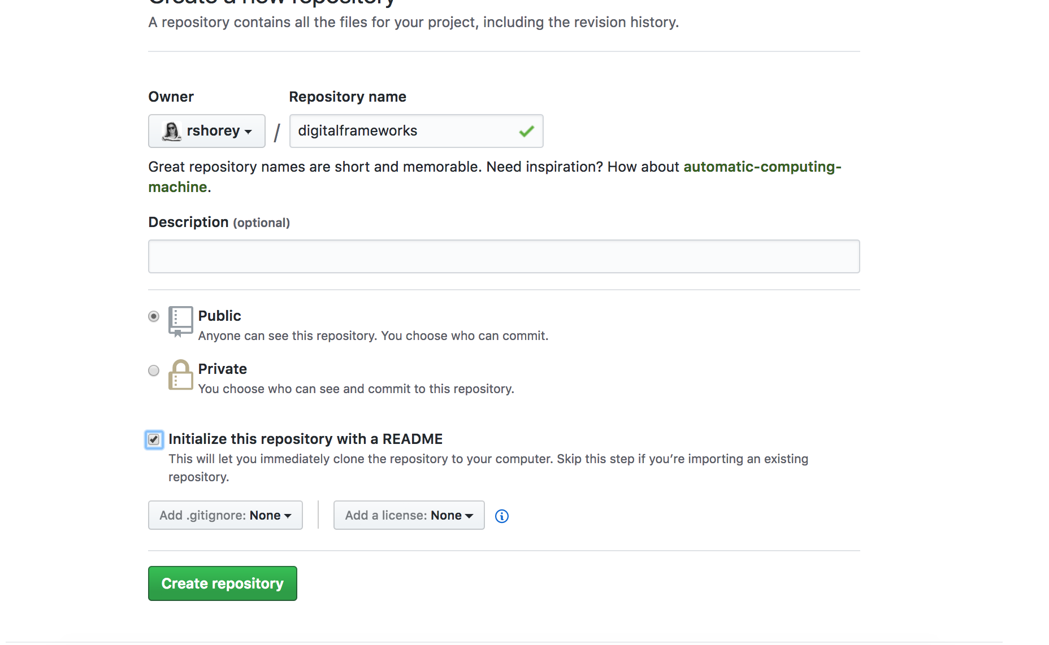
Github: Create a new repository
Call your repository digitalframeworks
Make it public
Check this box
Notes:
A repository is like a folder. That’s what it’ll look like on your computer.

Slide 90
BUT WAIT
I need to know where to find your repo!
Add your git username to this google sheet:
https://docs.google.com/spreadsheets/d/1RV9yFuIXRnVsGx14vedCYKgSzAiQqmt2vWqII5wBamk

Slide 91
Markup languages
We’ll be writing our assignments in Markdown.
Markdown is a markup language
Anyone familiar with other markup languages?
Notes:
HTML, XML, LaTeX
HTML: Hypertext markup language
XML: Extensible markup language

Slide 92
Markup languages
“A markup language is a system for annotating a document in a way that is syntactically distinguishable from the text.” --wikipedia

Slide 93
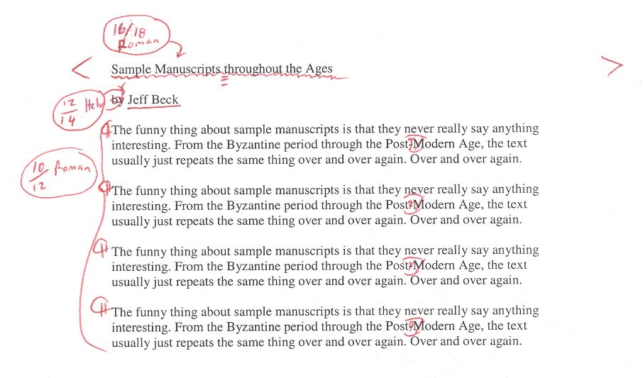
Markup languages
Notes:
Markup languages actually have a nice journalism history. The idea is to do digitally what writers and editors used to do with a red pen

Slide 94
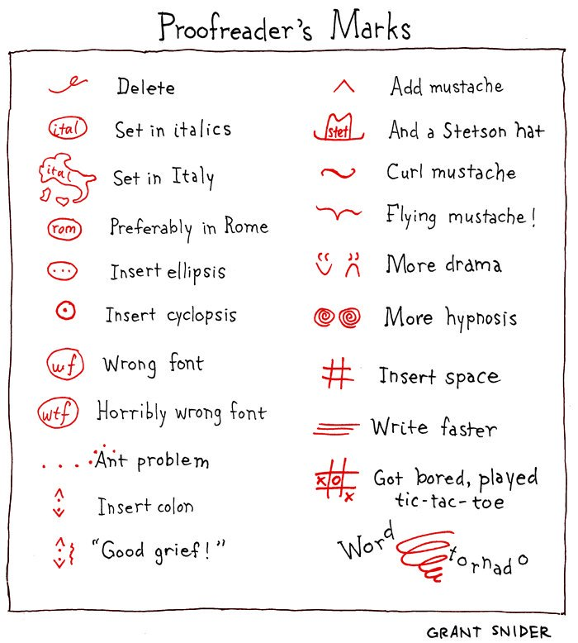
Markup languages

Slide 95
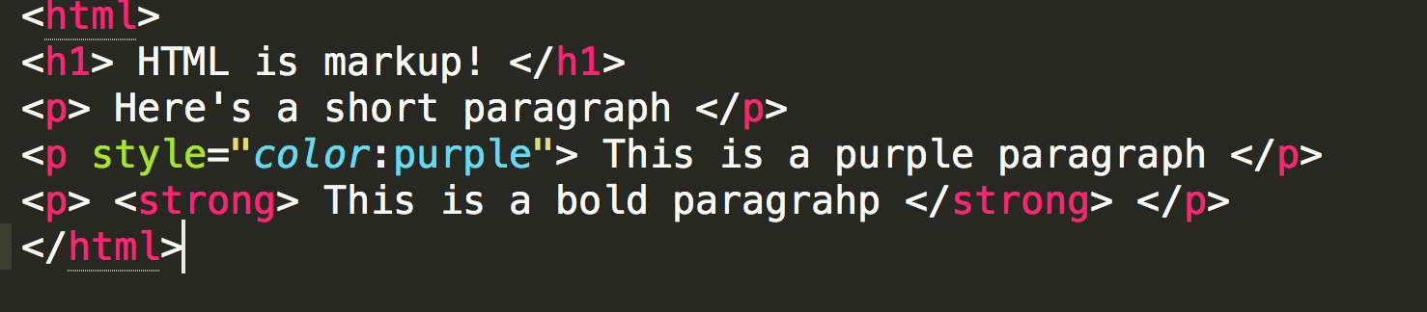
An HTML example
Notes:
You’re likely at least slightly familiar with HTML

Slide 96
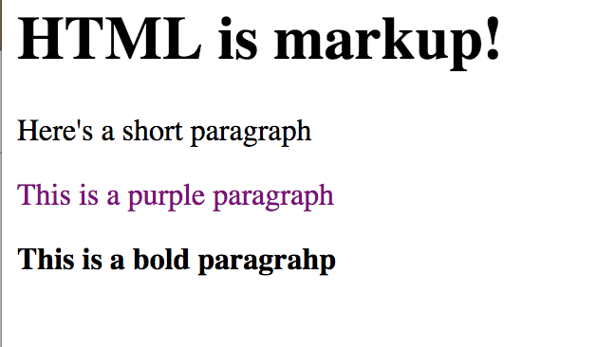
An HTML example
Notes:
And this is what it looks like on the web. The tags (which are the markup part) dictate things like size, emphasis, color, spacing…

Slide 97
So why not just use HTML?
We’re using Markdown because:
It is easy to read raw
Github just renders it - no need to get hosting
If you ever work on a data or tech project, even as a non-tech person, it’s likely what instructions/documentation are written in

Slide 98
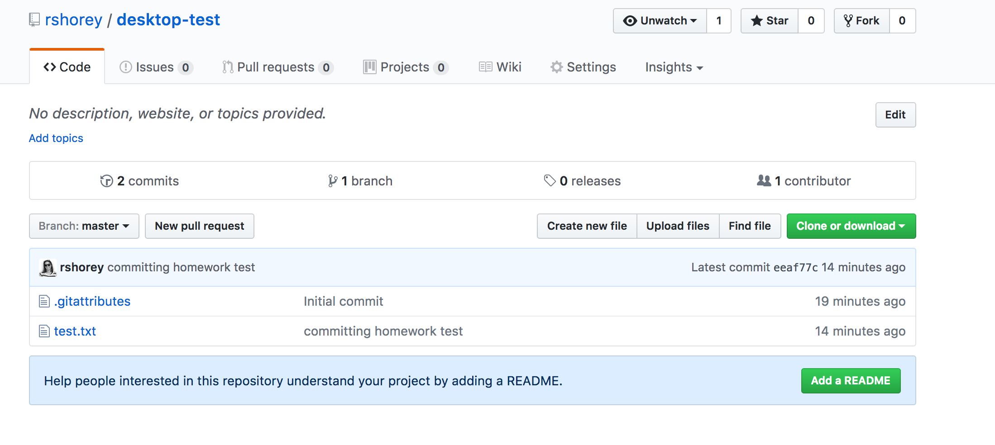
Create a new file (Call it learning_markdown.md)
Notes:
By ending the filename with the extension .md, github knows it’s markdown, and gives you some magic. Please do not include any spaces in your filename, they tend to cause trouble later.

Slide 99
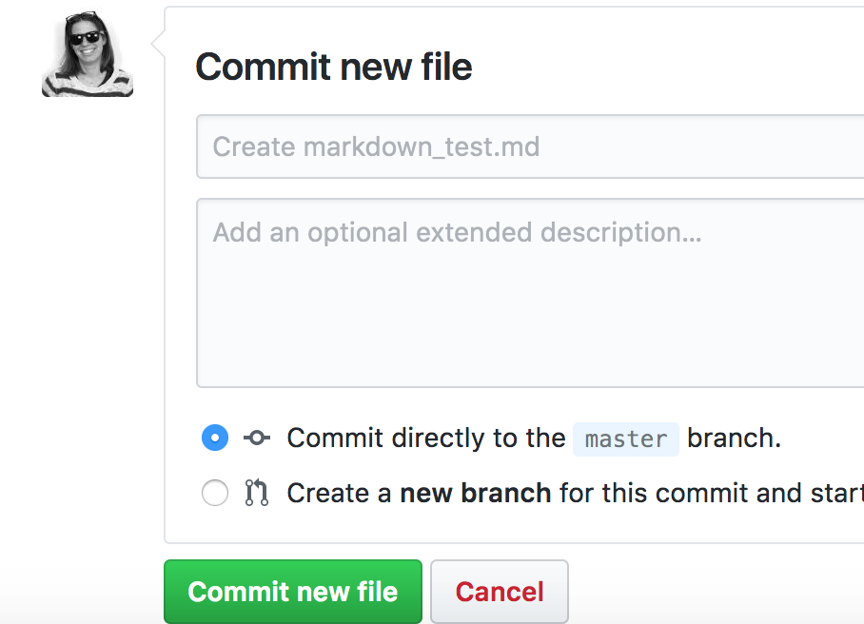
At the bottom, write a description and commit changes.
Notes:
It doesn’t really matter what you write but if you make changes later it can be helpful to make a note about them. For example: “added quotes from interview with Joe Smith”
This is how you save the file. You can (and should) do it often.

Slide 100
Fundamentals of Markdown
Headers look like this:
# h1 (the biggest)
## h2
### h3 ...

Slide 101
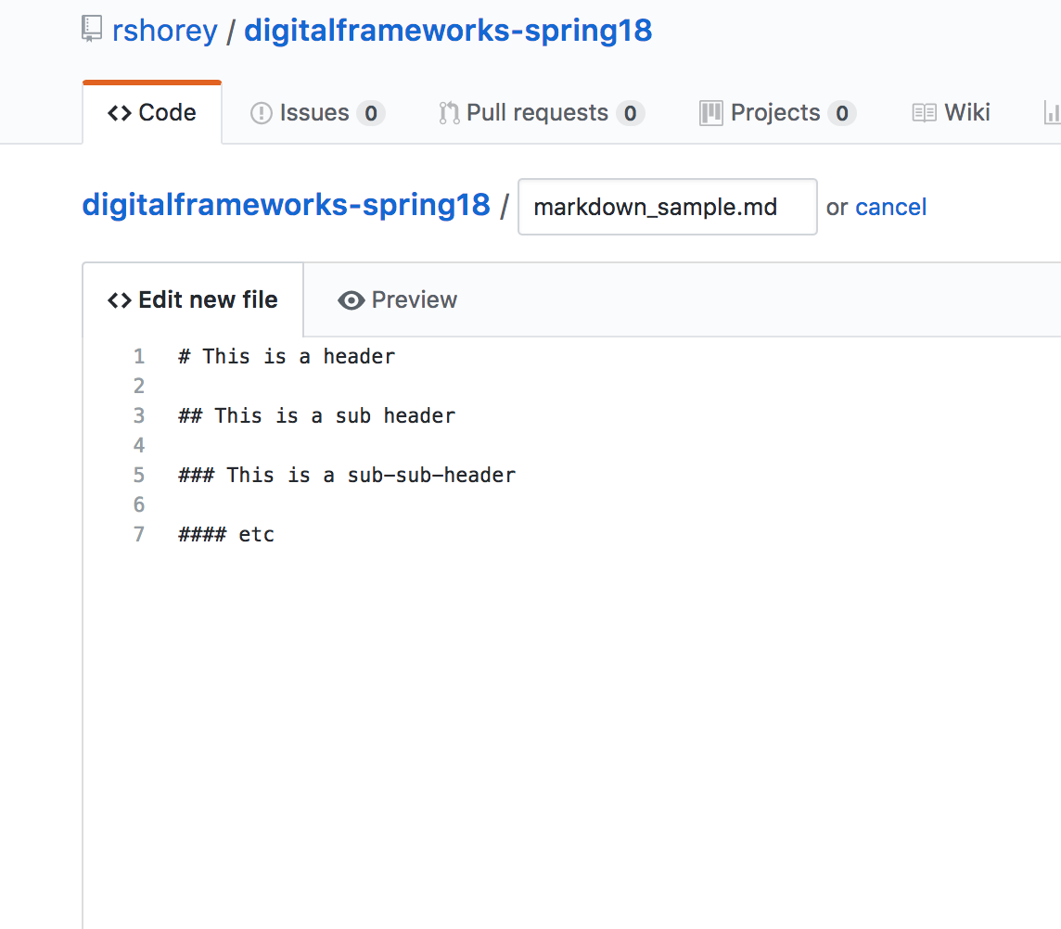
Let’s give it a try!
Once you’ve entered some text to test out headers, click the preview button.
Notes:
You can commit/save first if you want (and you should do that often) but preview works even if you don’t.

Slide 102
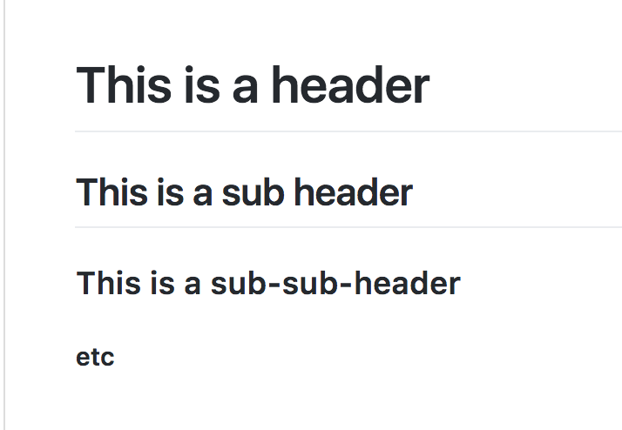
Let’s give it a try!
Notes:
You should end up with something that looks like this. Next we’re going to run through a few other things that markdown can do, and I’ll point you at some resources. Go ahead and try them out, and then hit preview to see it in action!

Slide 103
Fundamentals of Markdown
Emphasis
*this text is italic*
_this text is ALSO italic_

Slide 104
Fundamentals of Markdown
Emphasis
**this text is bold**
__this text is also bold__

Slide 105
Fundamentals of Markdown
Emphasis
*this text is italic __but this part is also bold__!*
**this text is bold _but this part is also italic_!**
Notes:
Why both the stars and the underbars for italic and bold? It makes it easy to combine them!

Slide 106
Fundamentals of Markdown
Strikethrough
~~this text is crossed out~~

Slide 107
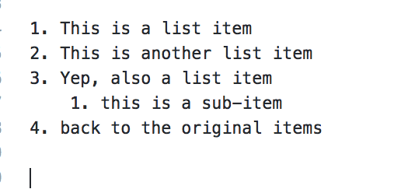
Fundamentals of Markdown
Lists (ordered)
Notes:
Ordered lists have numbers (or letters or whatever), unordered lists are like bullet points.

Slide 108
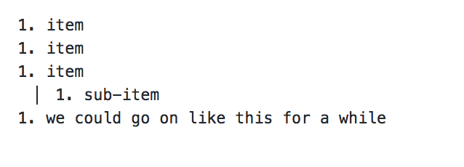
Fundamentals of Markdown
Lists (ordered)
Notes:
Have you ever made a list, and realized you have to go back and add an item at like #3 and then have to re-number the whole thing? Markdown knows about that bad problem, so you actually don’t need to number your list. You can just use 1. For every item and it numbers them automagically.
(note that to get the sub-item to work, you need 4 spaces)

Slide 109
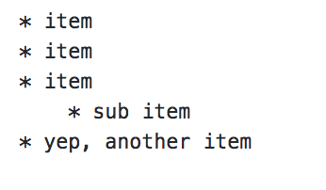
Fundamentals of Markdown
Lists (unordered)
Notes:
This is going to look familiar

Slide 110
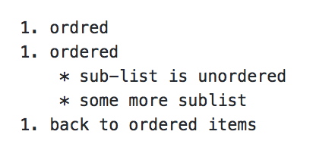
Fundamentals of Markdown
Lists (you can combine ordered and unordered)

Slide 111
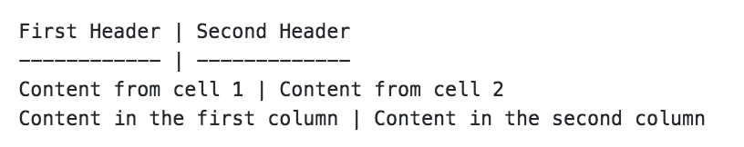
Fundamentals of Markdown
Tables
Notes:
You basically make a thing that looks like a table with pipes and underscores. You don’t have to be precise about spacing or anything, it figures it out and makes you a nice little table!

Slide 112
Fundamentals of Markdown
Links
[text](url)
For example:

Slide 113
Markdown and homework
You’ll be submitting your in-class assignment as a markdown file on github with the title assignment1.md (or assignment2.md, etc).

Slide 114
Markdown and homework
For this week, you’ll be finding a news story that relies on data and writing a brief critique. Full assignment specs on the syllabus.

Slide 115
Markdown and homework
You should be able to finish in class, but if not, it’s due before the next class begins.

Slide 116
First steps:
Create and commit a file
(after that, you may get started looking for a data story on your own)

Slide 117

First steps:

Slide 118

First steps:

Slide 119

First steps:

Slide 120

Once you’ve committed, you can edit again. First click the file (if you’re on the main page). Then click the edit button.
Notes:
Don’t forget to commit after every edit

Slide 121
Today’s assignment is here:
https://github.com/rshorey/digitalframeworks-spring18/blob/master/assignment1.md
a shortened link that will work for about 3 hours is here: www.yellkey.com/economy

